Slide 1
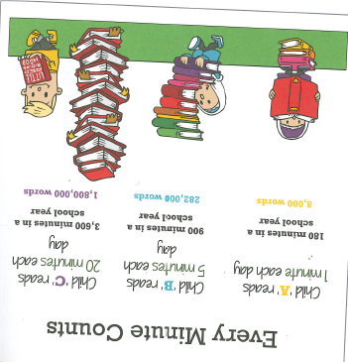

Slide 2
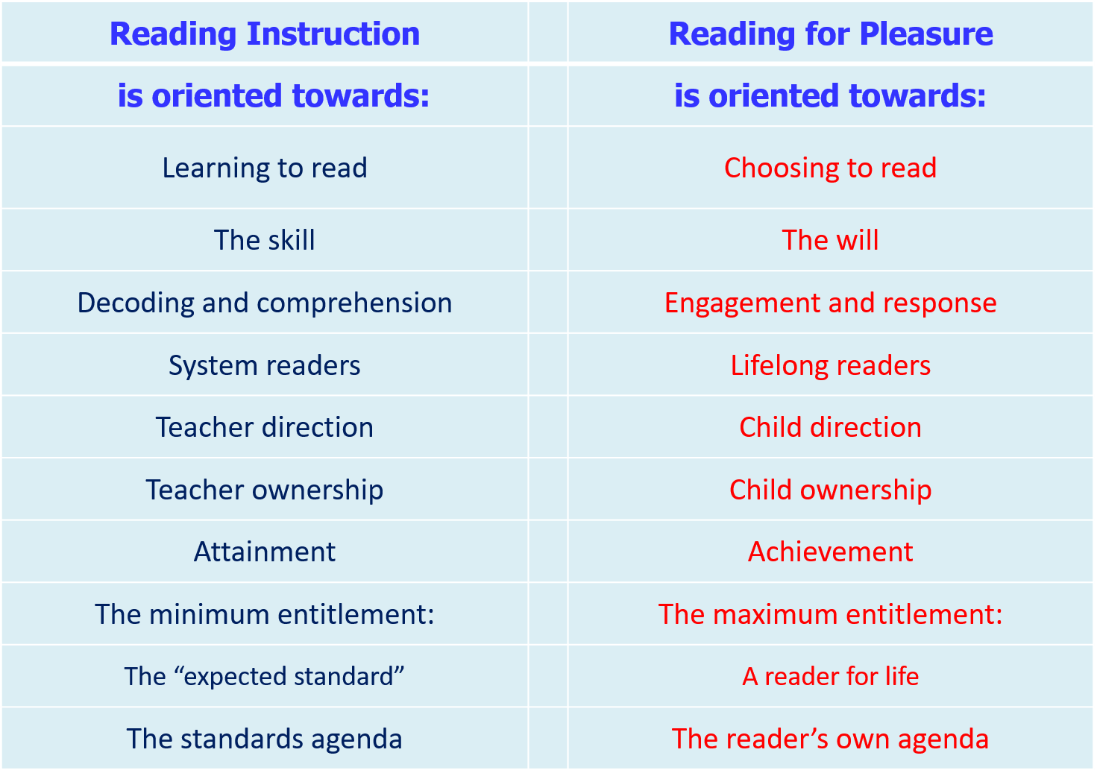

Slide 3
Reading Partnership
Of all the help you can give your child, the most important job you’ll probably do is helping with reading. That’s because learning to read is best taught on a one-to-one basis, so giving your child a bit of shared reading time every day will make a big difference. They should be reading a range of genres and reading aloud to enable them to develop expression, intonation, confidence and fluidity in their reading. This should not stop even when a child becomes an independent reader.
We know that being able to read underpins everything a child does in school and is directly linked to their self-esteem, confidence and achievements as they go through life.

Slide 4
Reading has two components
Word Recognition
(decoding)
The ability to recognise words presented in and out of context.
The ability to apply phonic rules -blending phonemes to decode (c-a-t)
High quality phonics work
Comprehension
The process by which word information, sentences and discourse are interpreted.
The same processes underlie comprehension of both oral and written language.
Continues to develop throughout life!

Slide 5
I can read really well!
In general, the management of behaviour in classrooms is not a function of the techniques of directly controlling behaviour –that is, desist style. Rather, it is a function of the techniques of creating an effective classroom ecology containing such variables as having a non-satiating learning programme, initiating and maintaining movement flow and aiming teacher actions at appropriate targets.

Slide 6
Comprehension and Decoding…
I may have been able to confidently read (decode) the previous slide but I didn’t really understand it!

Slide 7
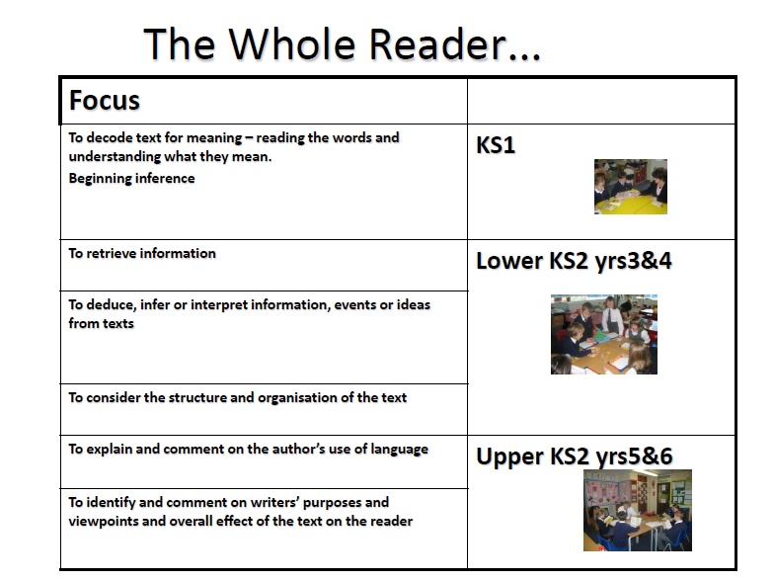

Slide 8
Reading at St. Teresa’s in Key Stage 2
English lessons focus on high quality texts and poetry
Children in Year 3 and 4 are given a colour banded book and are encouraged to also have a book for ‘pleasure reading’
Children in Year 5 and 6 choose their own reading books –we encourage and guide
Children in KS2 are not heard read as in KS1 unless they need support
3x weekly whole class Guided Comprehension lessons – VIPERS
Children are asked to read a minimum of 3x weekly (Reading Records)
Class novel is shared each day at 3pm
100 Reads award/Prayer Partner Reads/visiting the school library

Slide 9
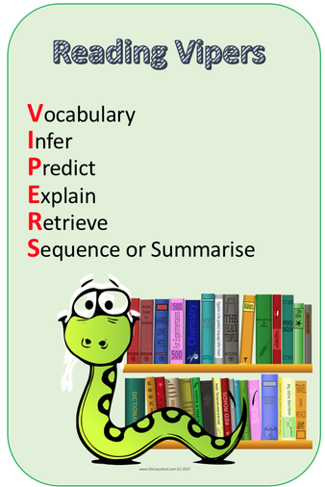
VIPERS
VIPERS is an acronym for the key reading skills taught in KS2
VIPERS stands for:
Vocabulary
Inference
Prediction
Explanation
Retrieval
Sequence or Summarise

Slide 10
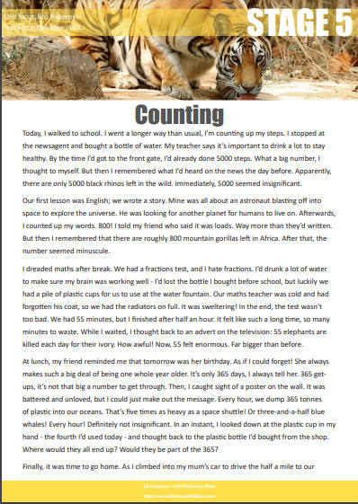
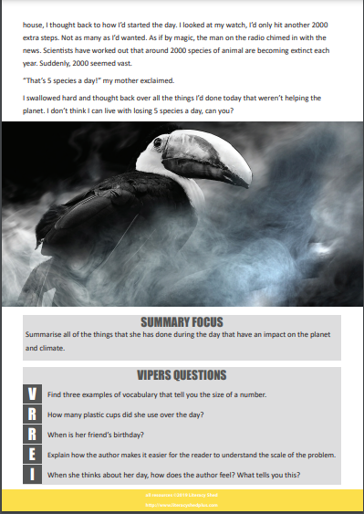

Slide 11
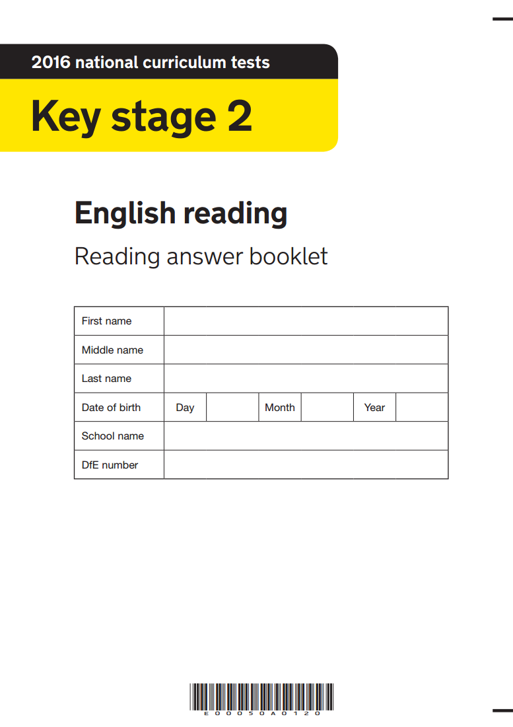
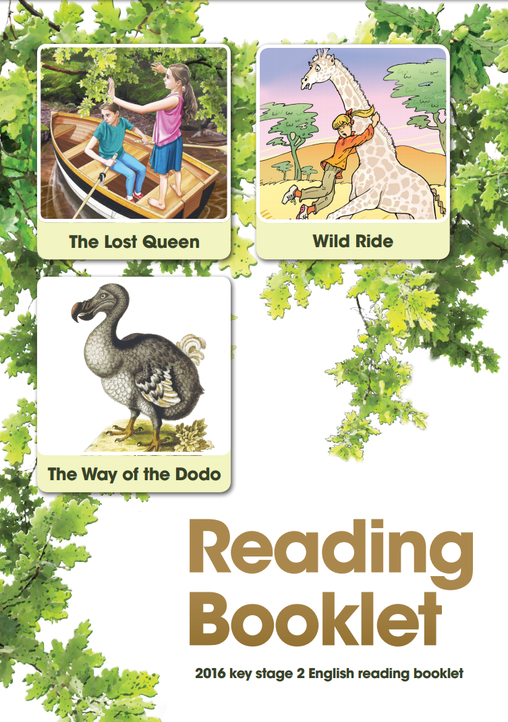

Slide 12
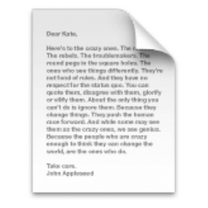
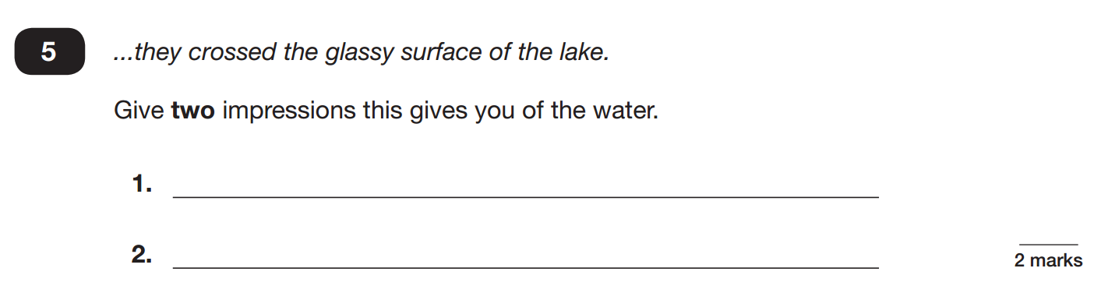
This is a quote from the text

Slide 13
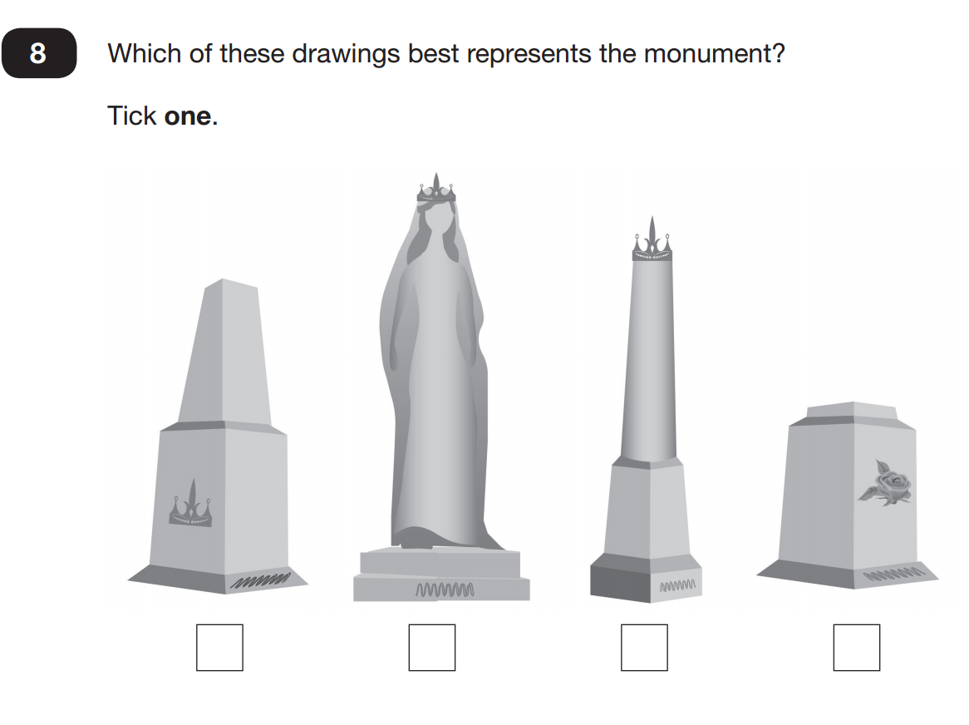

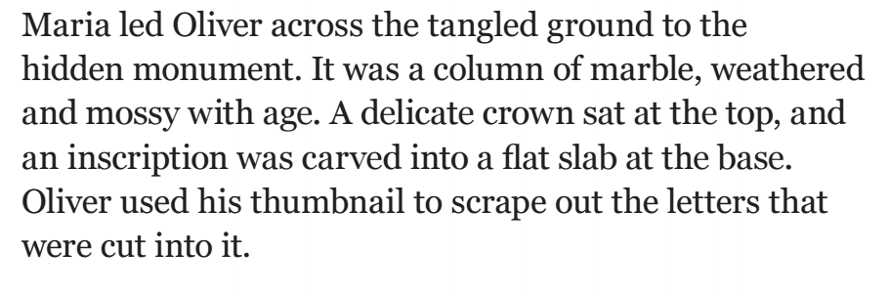

Slide 14
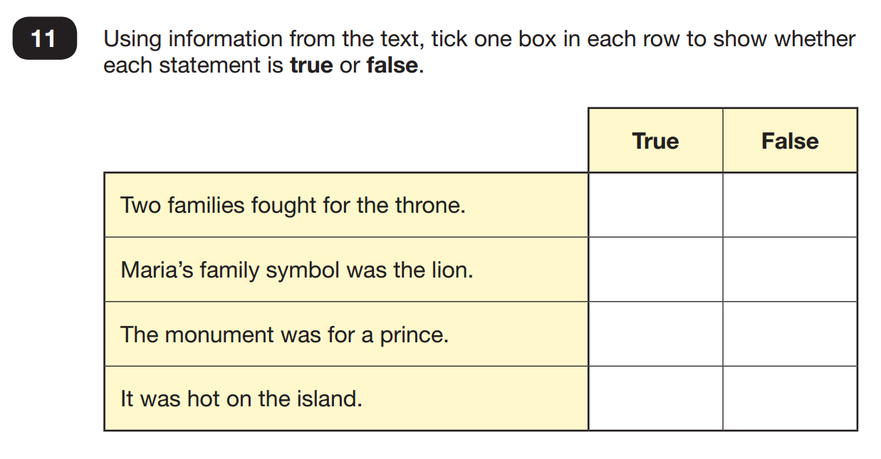
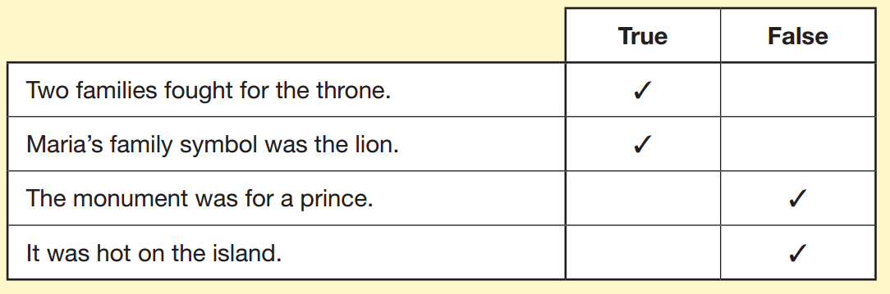

Slide 15
How can adults support children in their reading at home?
•Give reading status and importance by reading every day with your child.
•Don’t let a child struggle over a word for too long! If it’s too tricky and they’ve used their strategies then help! Allow time to self-correct. Children will scan down the page. Follow with finger word by word.
•It is a good idea to share reading aloud as you can model pace, expression and fluency for your child. ‘story teller voice’. Model reading sentences back.
•Encourage your child to read a range of texts such as comics, newspapers, non-fiction, plays and poetry etc.
•Encourage your child to read a series of books from a favourite author or books on topics of interests, especially to keep reluctant readers interested in reading.
•Use plenty of praise.
•Use questioning without interrupting the flow of the story!

Slide 16

reading-lists-for-ks2-school-pupils-pupils-ks2

Slide 17

Writing in Key Stage 2
Writing and the development of children's creativity and resilience when writing is our whole school focus this year.
Children are less likely to write in ‘real-life’ then ever before with use of technology
The use of technology has led to use of ‘text-speak’ rather than crafting sentences with punctuation and grammar considerations.
Children’s resilience has declined due to ‘the instant’
Writing skills are key as children will need them throughout their educational life and beyond!

Slide 18
How do we teach writing in KS2 at St. Teresa’s?
English lessons
High quality texts-model texts
Poetry
Grammar and punctuation
Modelling
Writing opportunities across the curriculum
Free write session
Writers clubs
Writers award
Awesome Authors
Writing for newsletters/sports reports
Purple book-Writing journey books
Does handwriting matter?

Slide 19
How can I help my child at home?
Real-life opportunities- card to Grandma, letter, lists
Support with homework each week
Support with weekly spellings
Do your children see you writing…
Notice words and spellings in the world around them

Slide 20
What is expected in KS2?
In Key Stage 2 we have ‘expected’ levels of writing-these levels are
produced by the Department of Education as part of the National
Curriculum.
Some children will continue to work towards these levels, some will exceed them –often those that exceed them are our most avid readers.
*Handouts

Slide 21
Thank you for coming this evening
Any questions?

