Slide 1
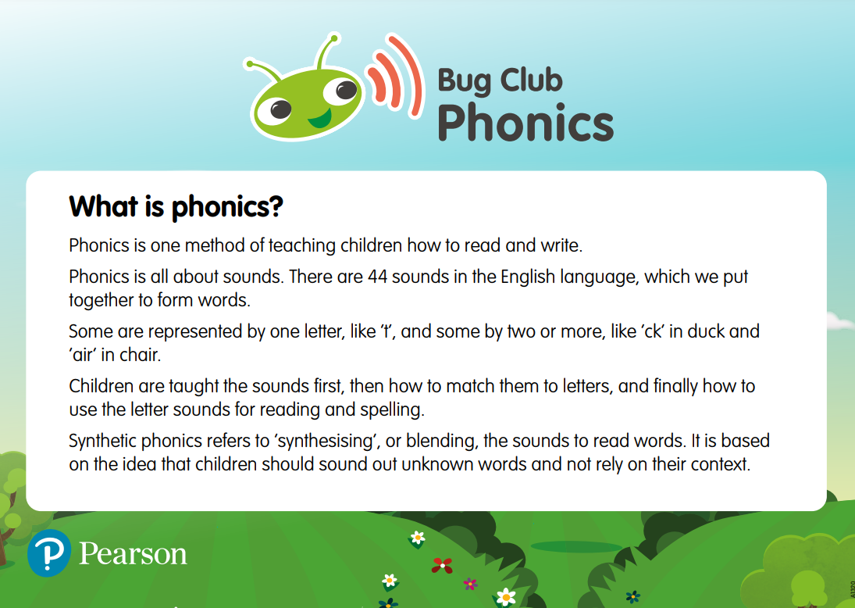

Slide 2

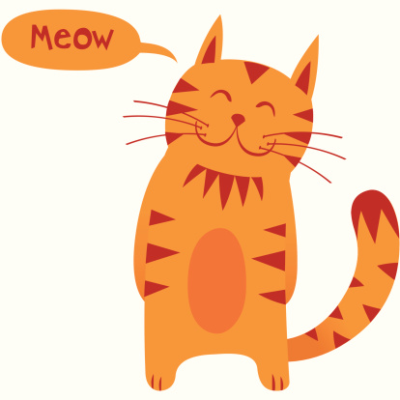

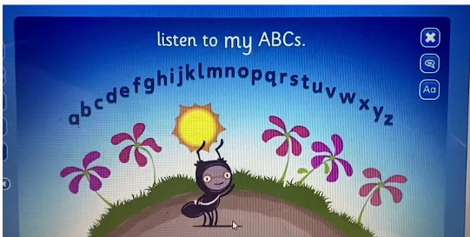
Letter Names vs Letter Sounds
One way to explain the difference between letters names and sounds is by saying the name of the animal is a ‘dog’ and the sound the animal makes is ‘woof’.
When we sing the alphabet song we are teaching the children about the letter ‘names’. We then teach the letter sounds (phonemes) in a carefully structured sequence of lessons. A ‘phoneme’ is the word we use to refer to the sound each letter makes. When we teach each phoneme it is important we use the ‘pure sound’.

Slide 3
Pure Sounds
Pure sound in phonics is the pronunciation of each letter sound clearly and distinctly without adding additional sounds to the end.
For instance, the /f/ sound is pronounced as 'f' and not 'fuh. An understanding of pure sounds will help children to blend and segment words.

Slide 4
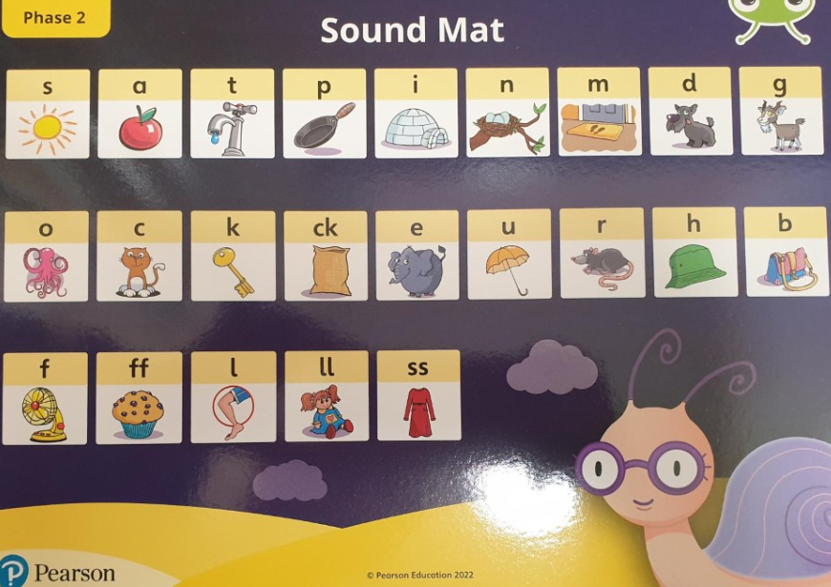
Click Here to see the correct pronunciation of the Phase 2 pure sounds*
*We do not follow the Twinkl Phonic programme but this video is an accurate representation of how to pronounce the sounds.

Slide 5
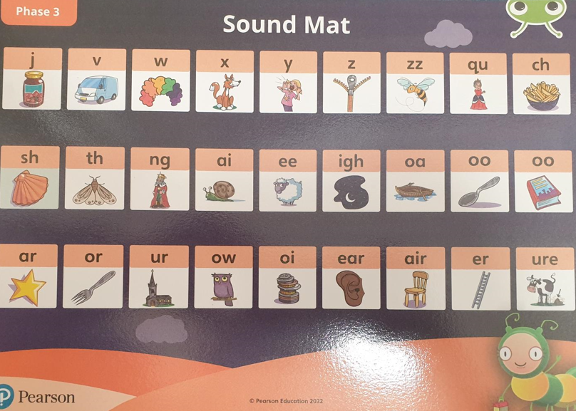
Click Here to see the correct pronunciation of the Phase 3 pure sounds*
*We do not follow the Twinkl Phonic programme but this video is an accurate representation of how to pronounce the sounds.

Slide 6
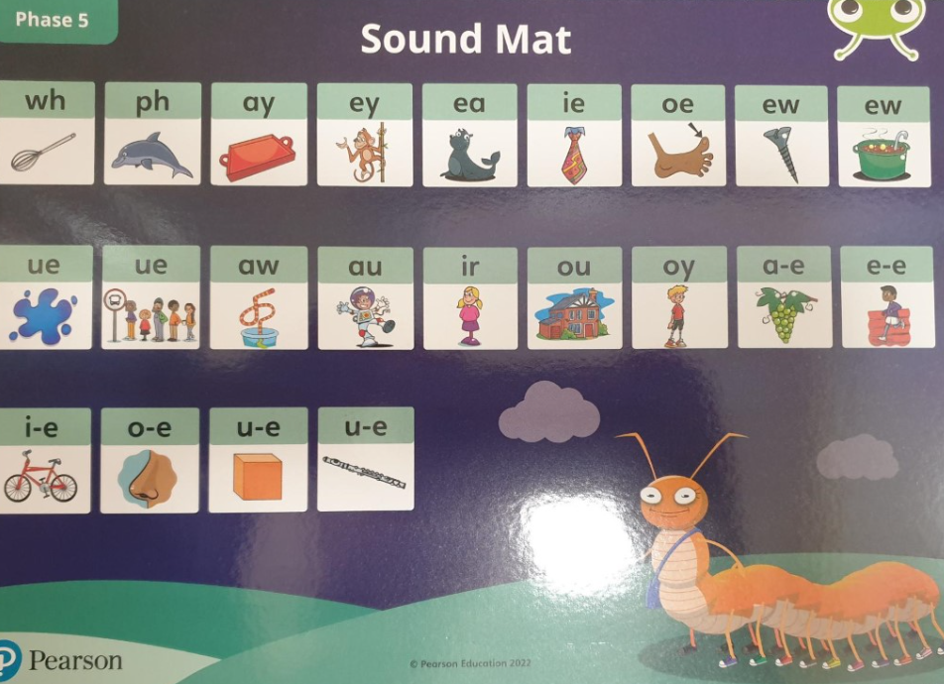
Click Here to see the correct pronunciation of the Phase 5 pure sounds*
*We do not follow the Twinkl Phonic programme but this video is an accurate representation of how to pronounce the sounds.

Slide 7
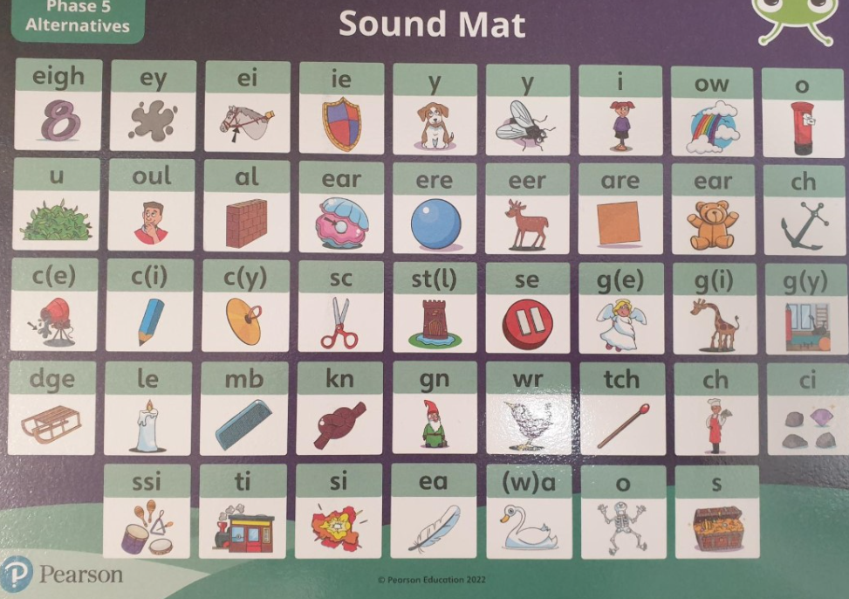

Slide 8
Tricky Words
Tricky words are words with an irregular spelling.
They are not fully decodable using the phonics skills taught at the point in which the tricky word introduced.
They are gradually introduced throughout the phonics programme.
Phase 2 | Phase 3 | Phase 4 | Phase 5
to the no go I into her | me be he my by she they we are you all was give live | said have like so do some come were there little one when out what | oh their people Mr Mrs Ms looked called asked water where who again | thought through work laughed because Thursday Saturday Thirteen thirty different any many | eyes friends two once great clothes it’s I’m I’ll I’ve don’t can’t didn’t first second third

Slide 9
Actions for Oral Blending & Segmenting

Slide 10
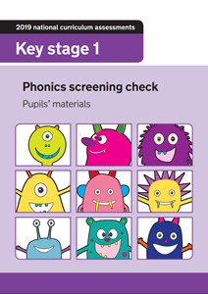
Year 1 Phonics Screening Test
A short reading test taken by Year 1 children in June to assess whether they have met the expected standard in Phonics.
Test contains 40 words
Combination of real and nonsense words (alien words)
Children who do not pass the test in Year 1 , will do another test in Year 2.
Child friendly, quick and most children enjoy demonstrating the phonics skills!

Slide 11
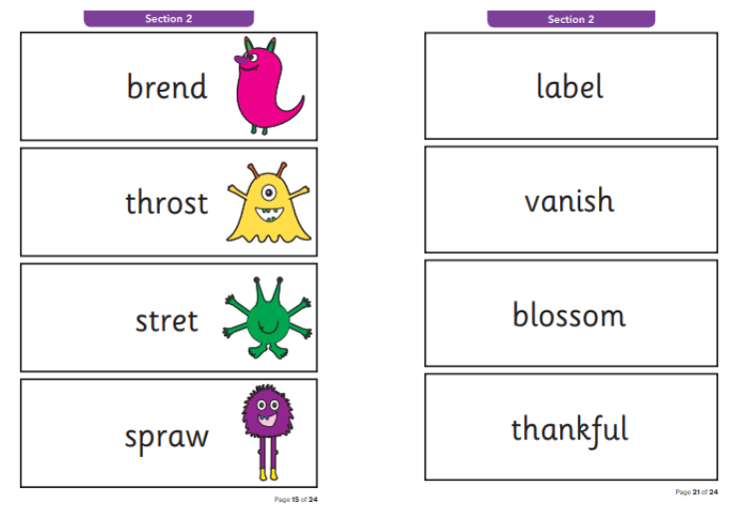
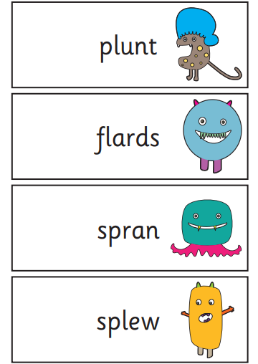
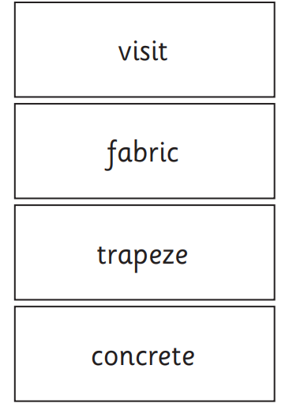
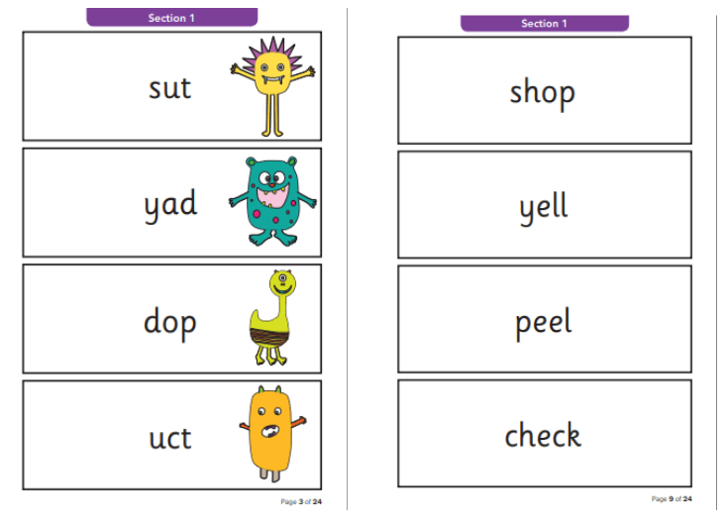

Slide 12
Any Questions?
Look out for communication regarding follow up Parent support reading workshops.
If you have any further questions please email the school office who will forward your questions to your child’s class teacher.

