Slide 1
Reading Books

Slide 2
Reading
Wordless Picture Books
There is no right or wrong way to read a wordless picture book!
A great resource to develop story telling language and play with new vocabulary.
Conversations around what is happening in the pictures will develop their comprehension (understanding) of what is happening. You may even notice there are things in the pictures that are unfamiliar, which could be a great conversation starter. They may look at the pictures and refer back to their own life and experiences, creating valuable learning links.
Sharing wordless books will build important literacy skills. Including listening skills, vocabulary, comprehension, and awareness of how stories are ‘built’.
For a book with few words you’ll be surprised at all the talking you will do and the fun you will have!
Top Tips for reading wordless picture books will have been sent home with your child’s first reading book.

Slide 3

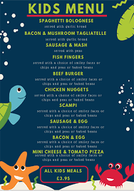
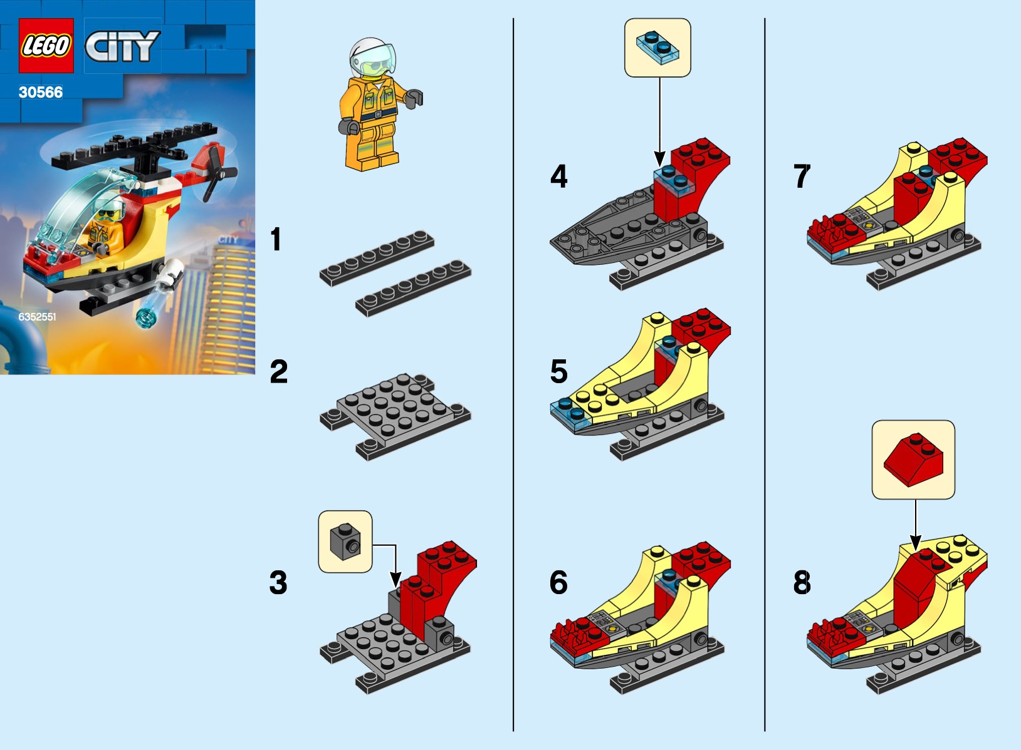

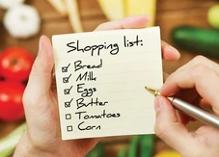

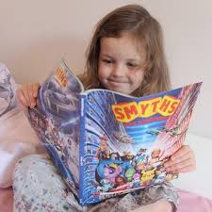
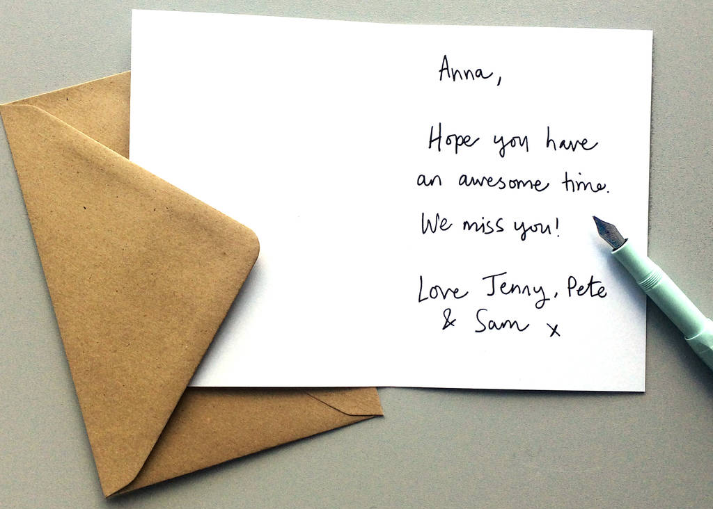

Reading is all around
Symbols
Calendars and timetables
Recipes
Instructions and Manuals
Leaflets and posters
Road signs and Car number plates
Shop labels and shopping lists
Comics and magazines
Catalogues
Post it notes
Letters and postcards
Menu
Birthday cards and tags

Slide 4
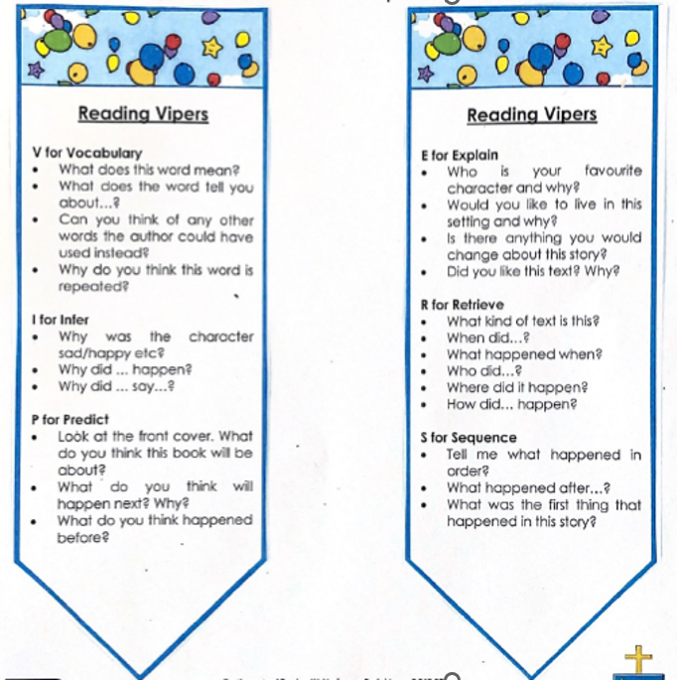
Comprehension
Comprehension is just as important as decoding!
Read each book more than once and continue to talk to your child about their book
Reading VIPERS: Vocabulary, Infer, Predict, Explain, Retrieve, Sequence
Asking questions based around these elements will develop your child’s comprehension skills.

Slide 5
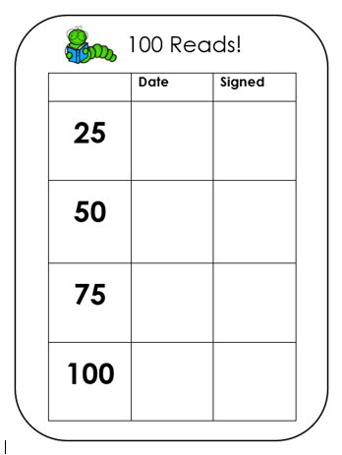
100 Reads
Incentive used across the whole school
Keep a tally of each time your child reads with an adult at home.
Once you reach each milestone, date the appropriate column in the front of your child’s reading record.
Your child will be rewarded with a sticker (25, 75), certificate (50), or Badge and Recognition in Smiley Assembly (100).

Slide 6
Expectations
Phonics practise
Sending books into school daily in book bags
Reading at least 3 times a week – checked in school
Sign and date reading records
Importance of repetition
Reading for pleasure

Slide 7
Any Questions?
Look out for communication regarding follow up Parent support reading workshops.
If you have any further questions, please email the school office who will forward your questions to your child’s class teacher.

