Slide 1
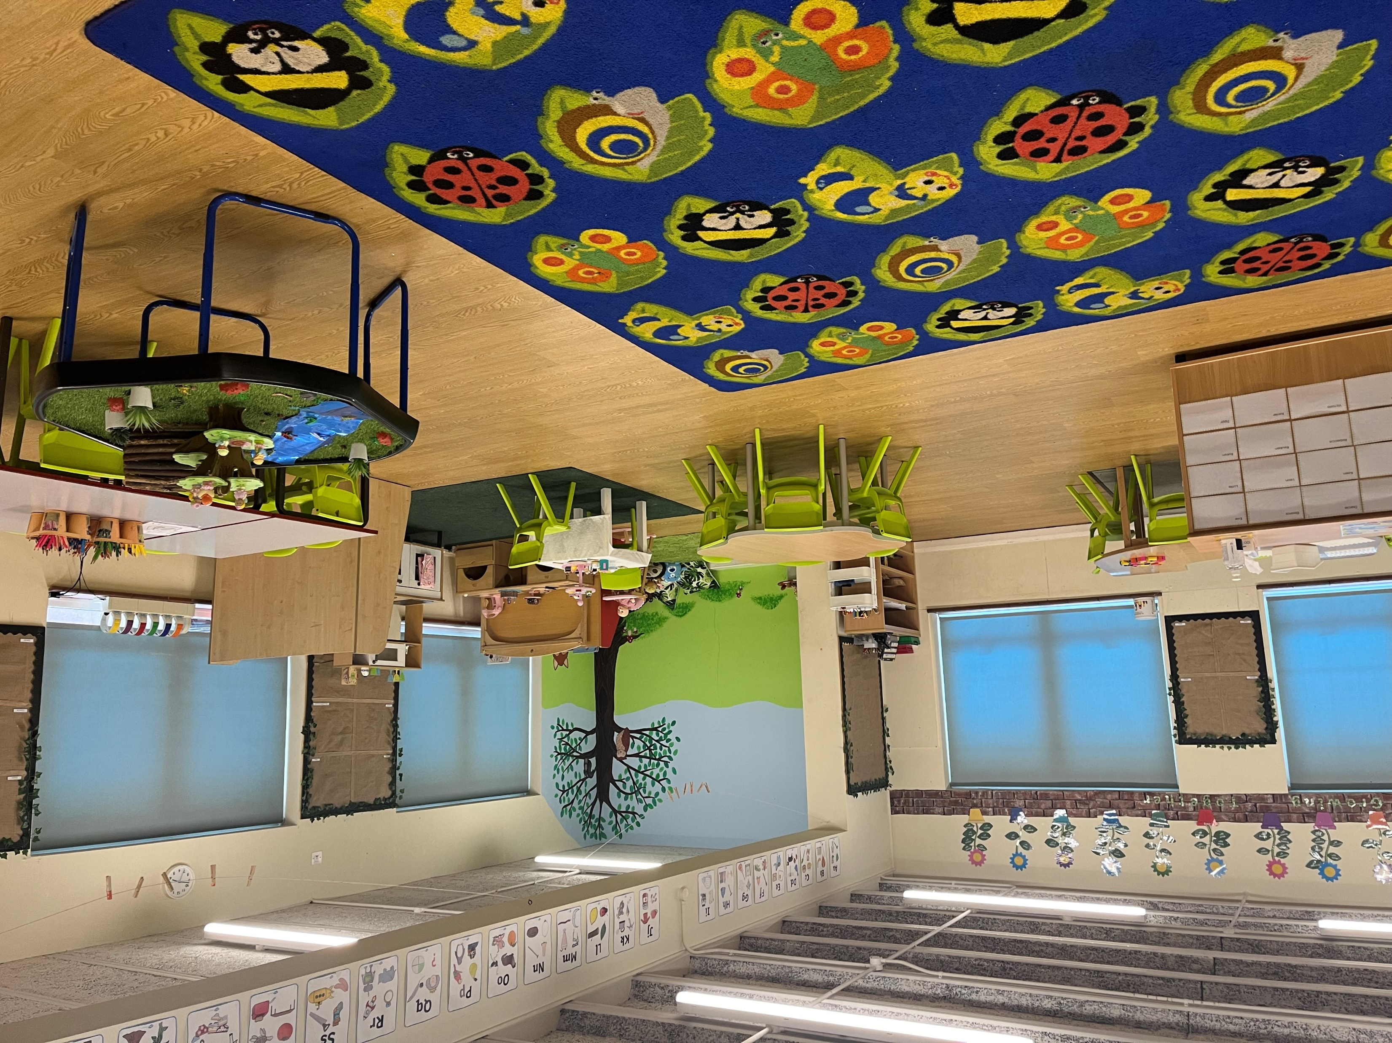
Welcome to Tamar

Slide 2

Who will help me?

Slide 3
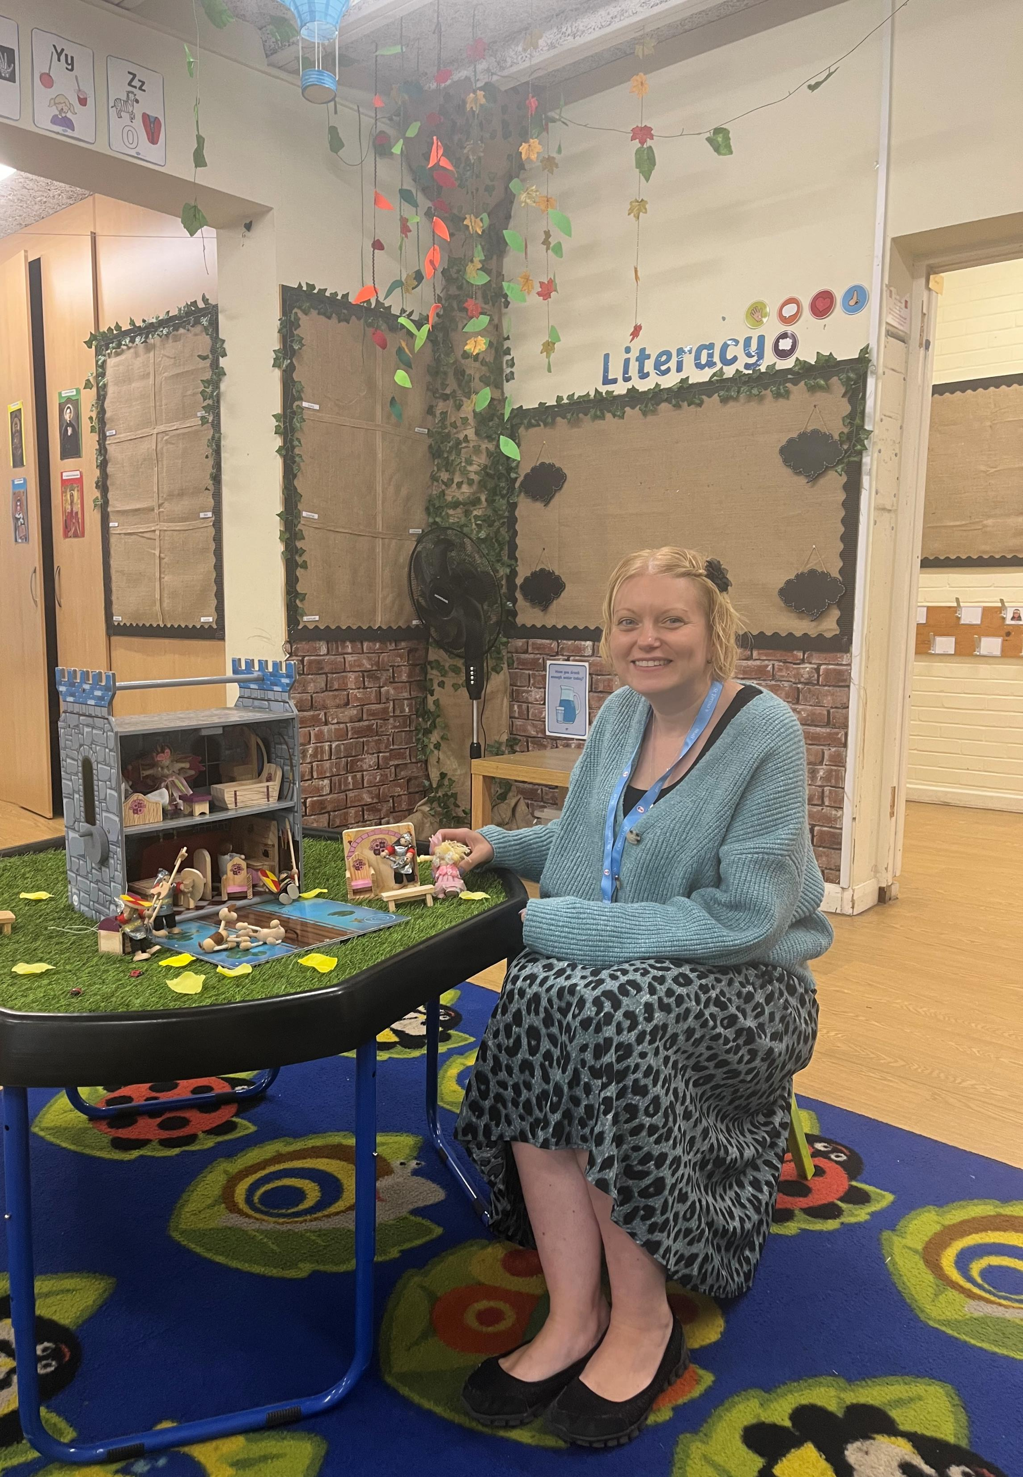
Mrs Richards

Slide 4
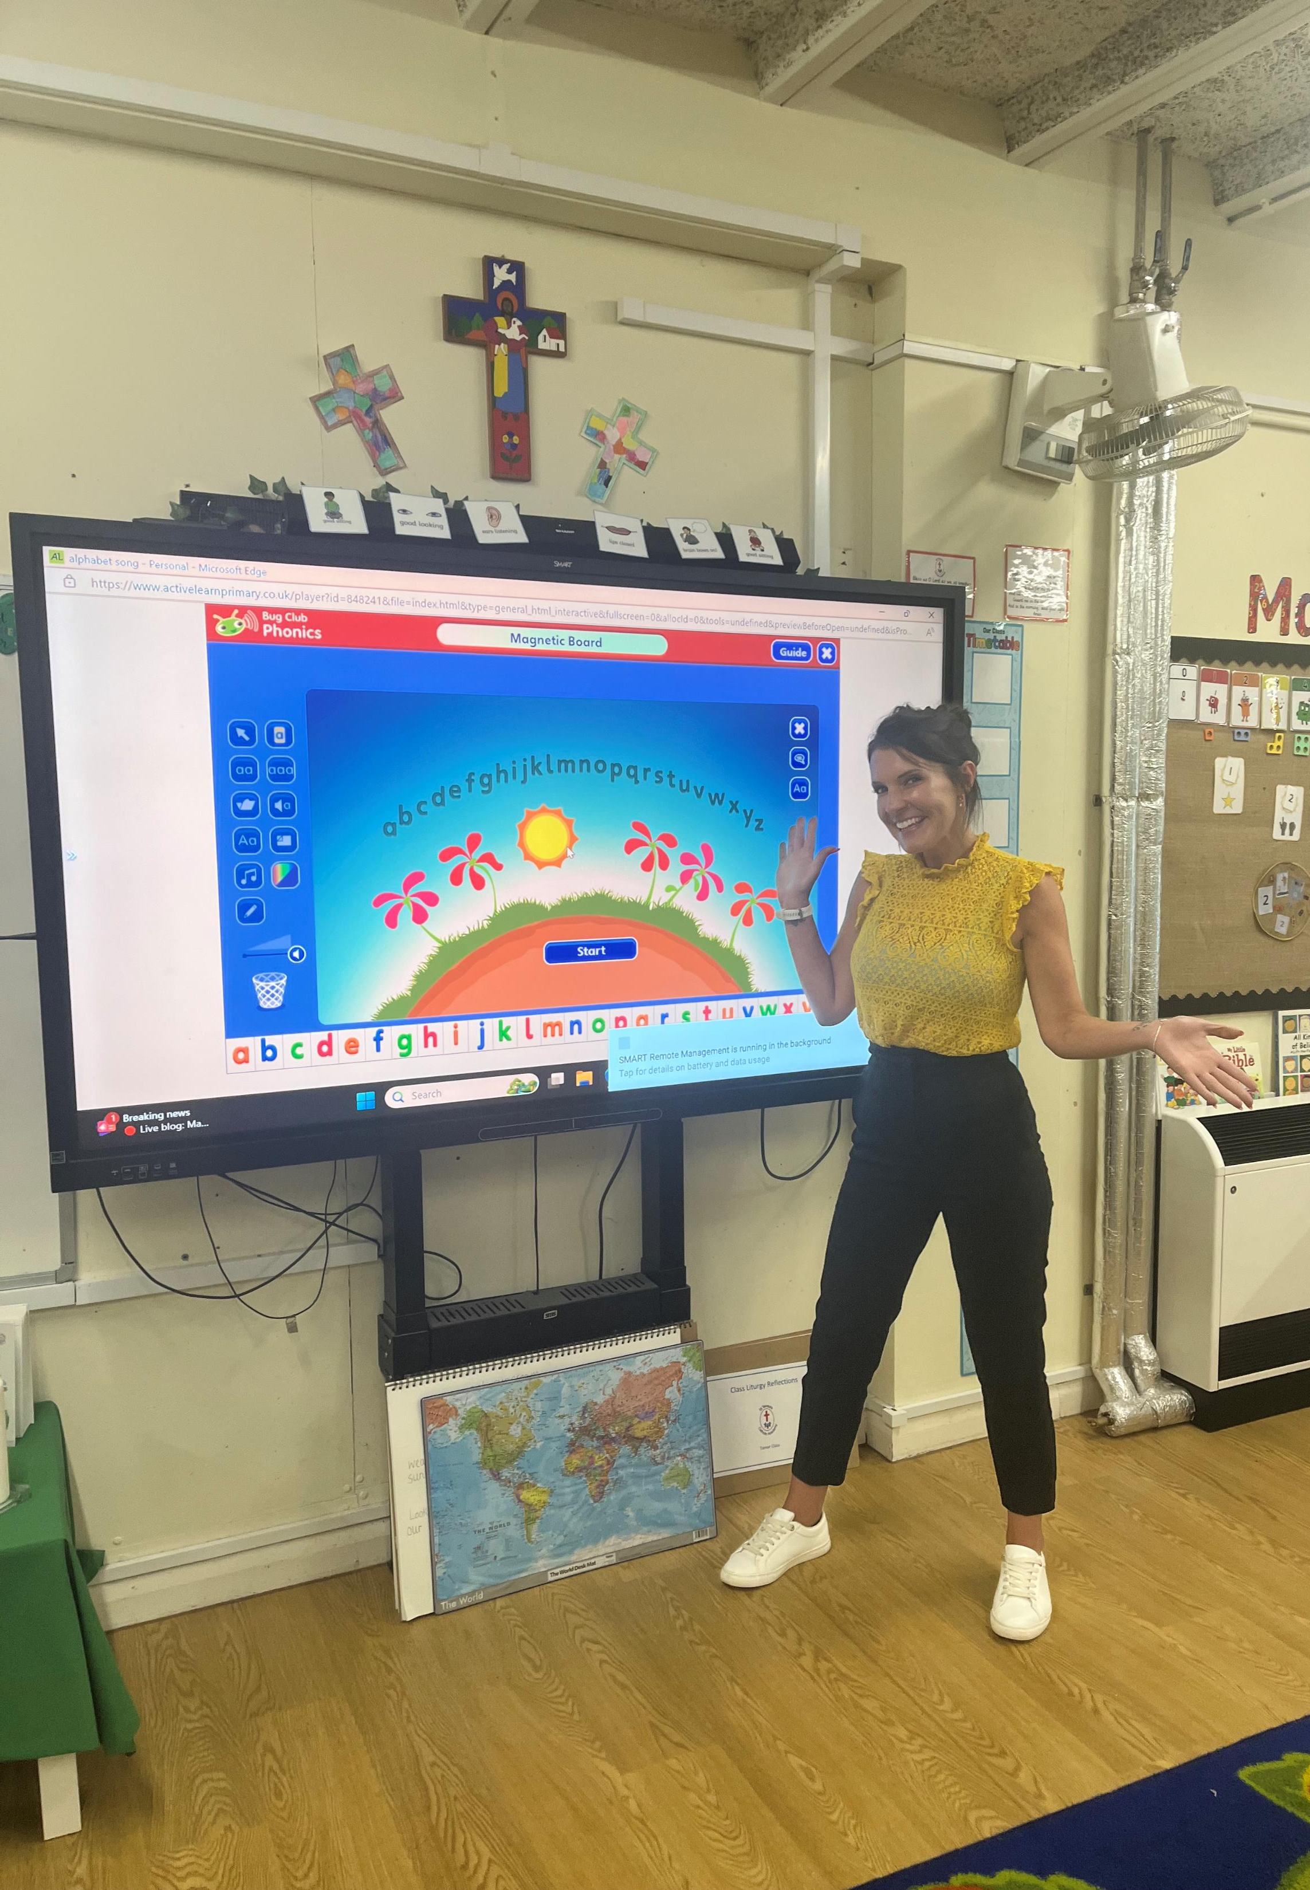
Mrs Storrar

Slide 5
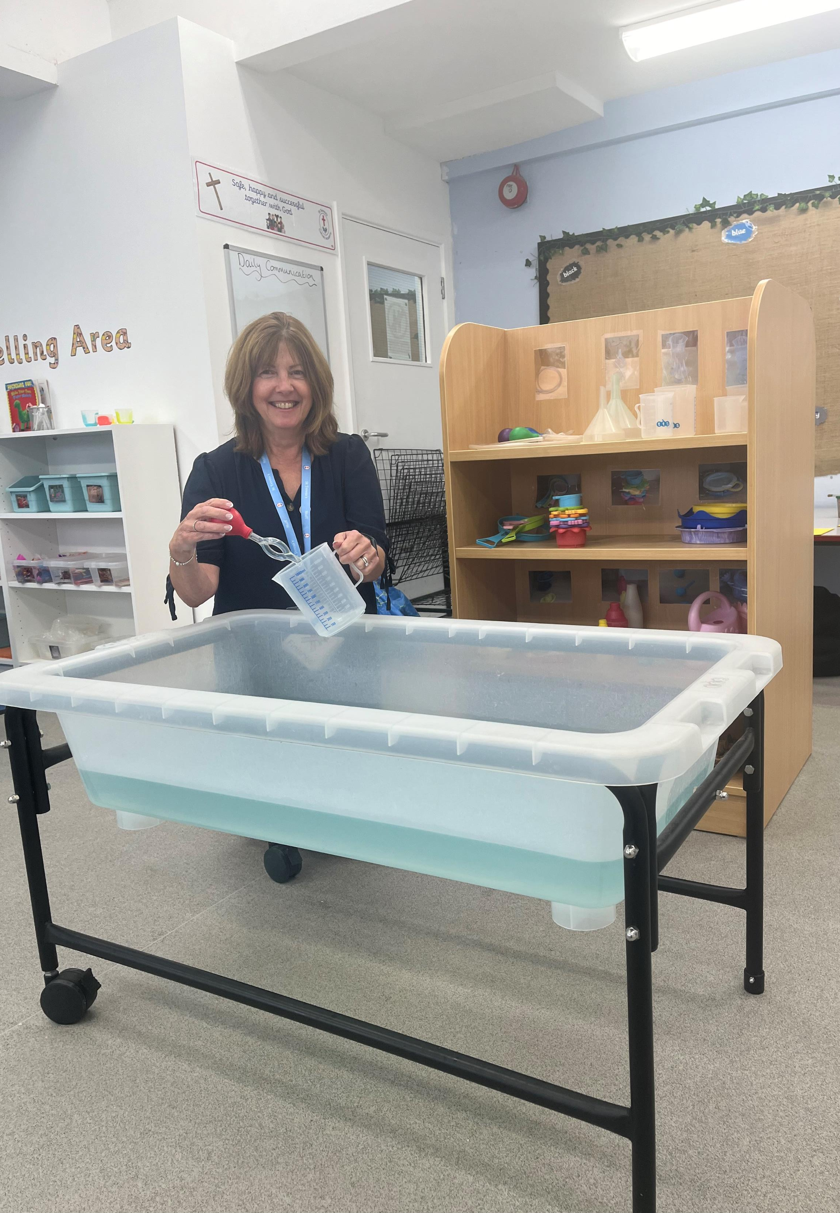
Mrs Cusden

Slide 6
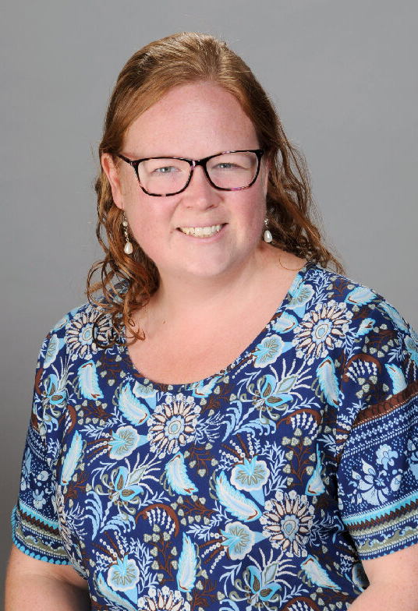
Mrs Hewitson

Slide 7
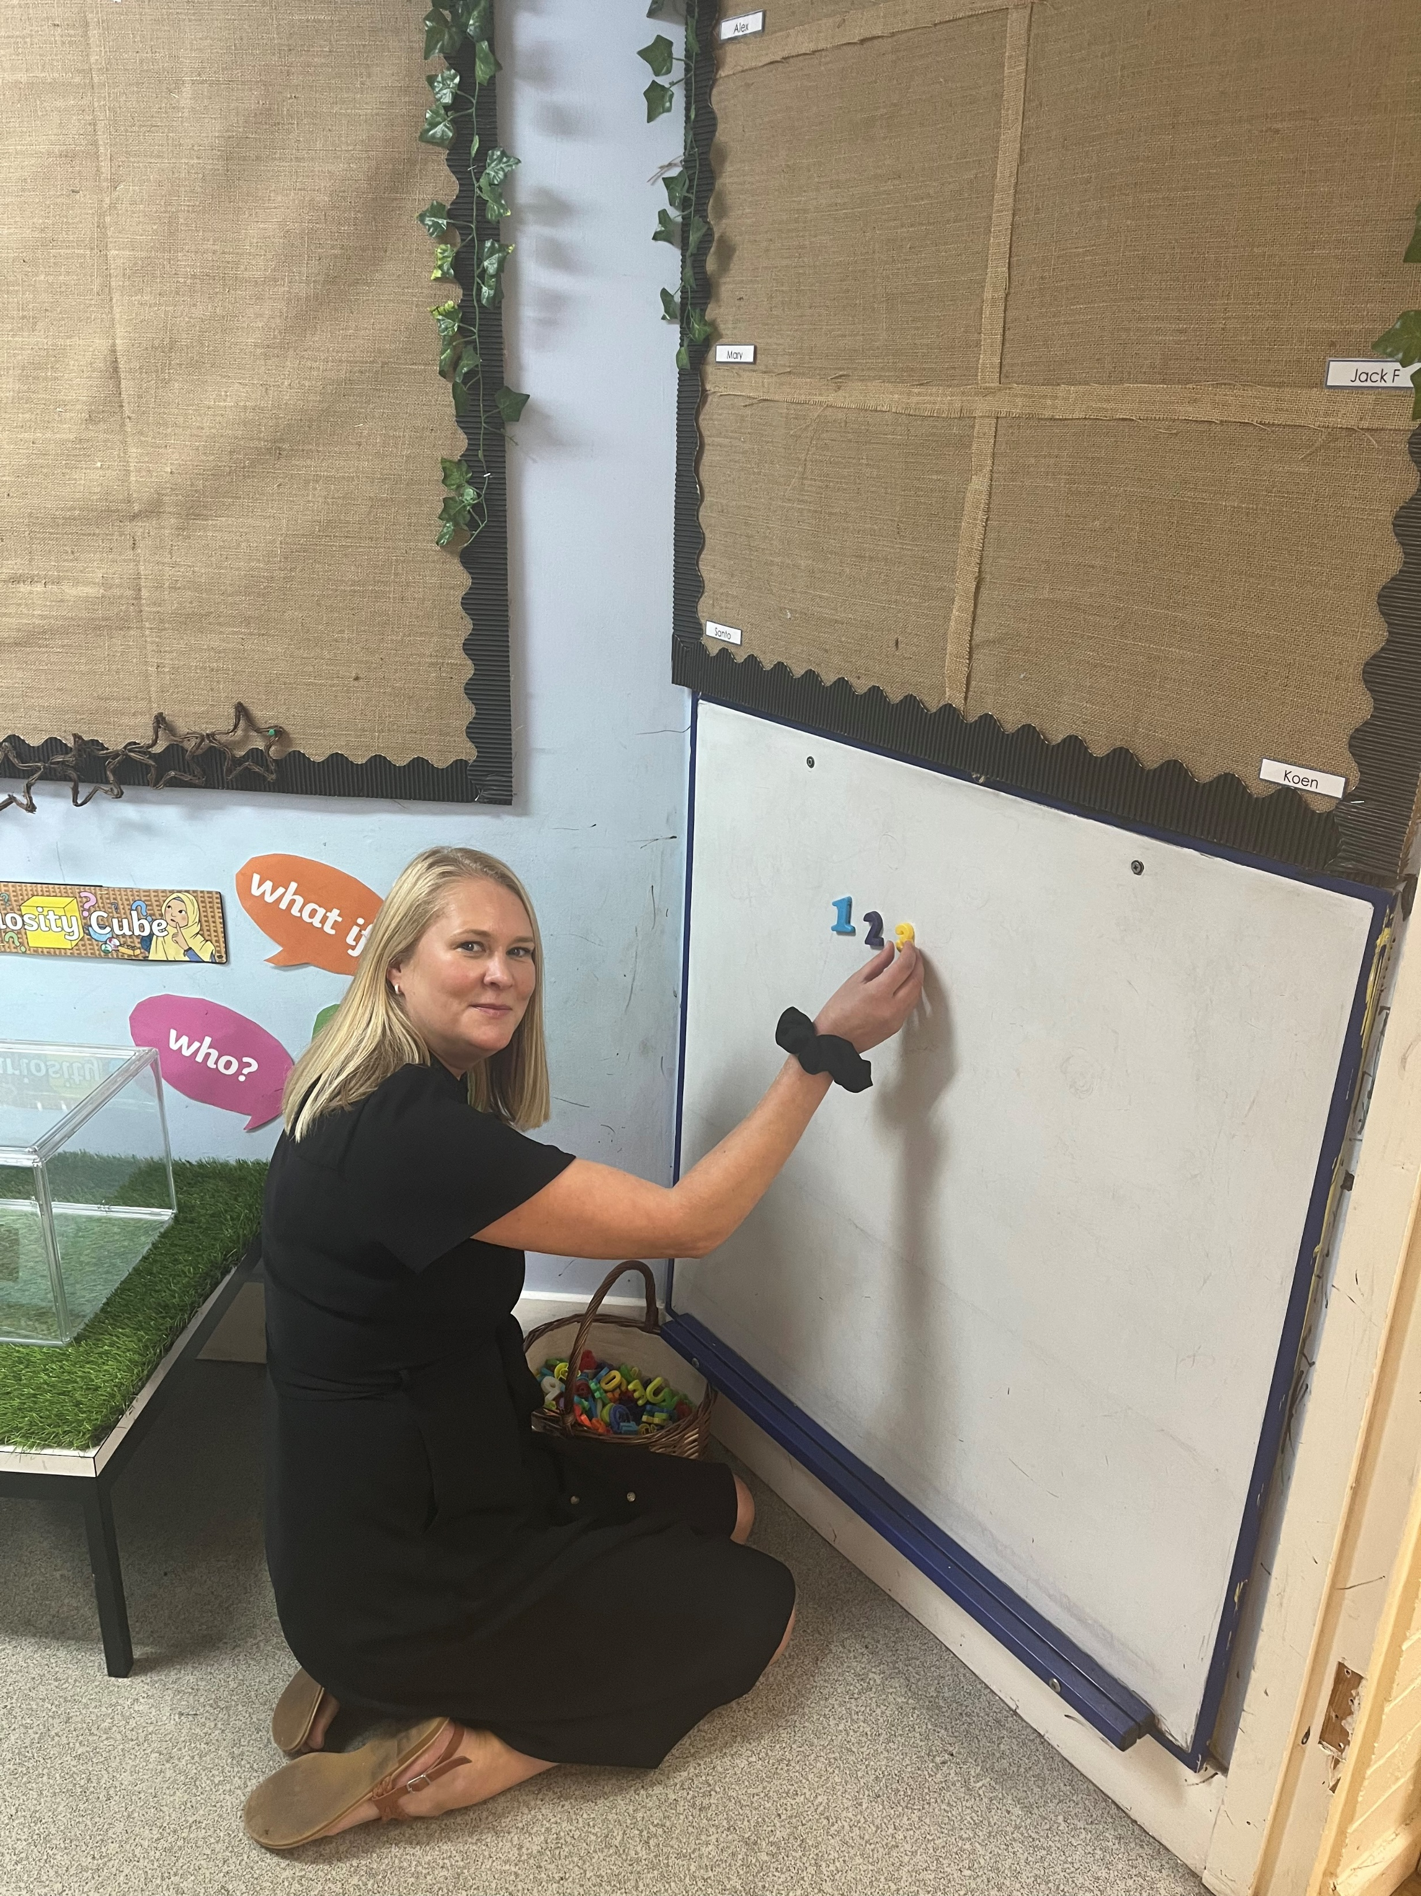
Miss Abel

Slide 8
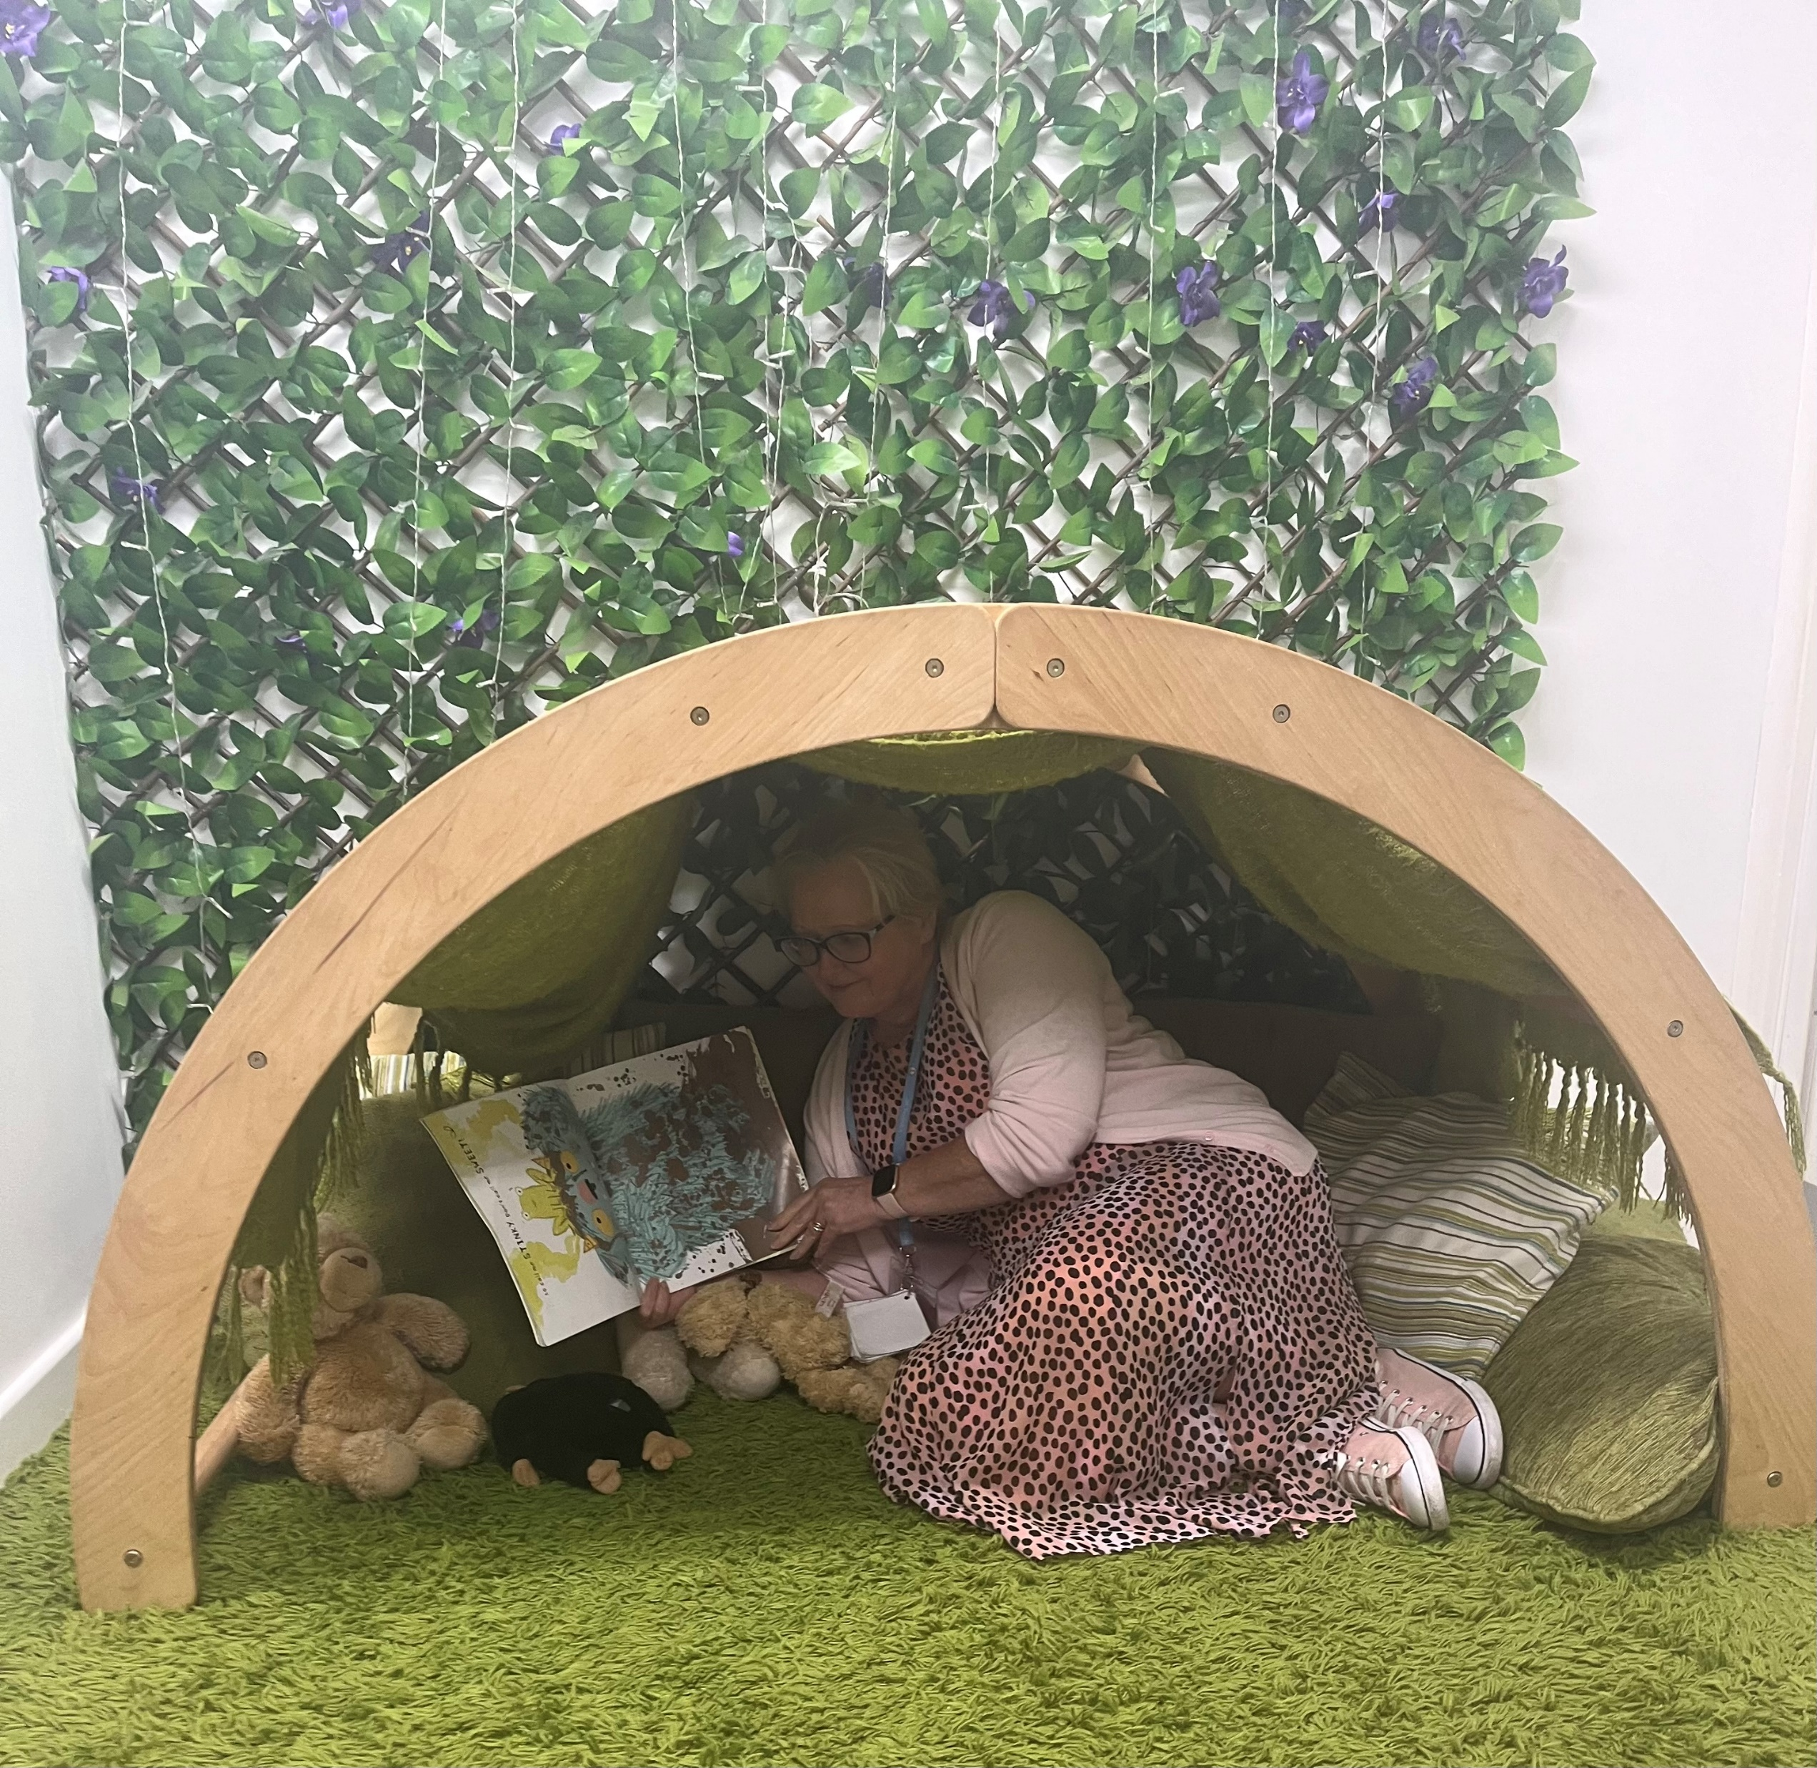
Mrs Robinson

Slide 9
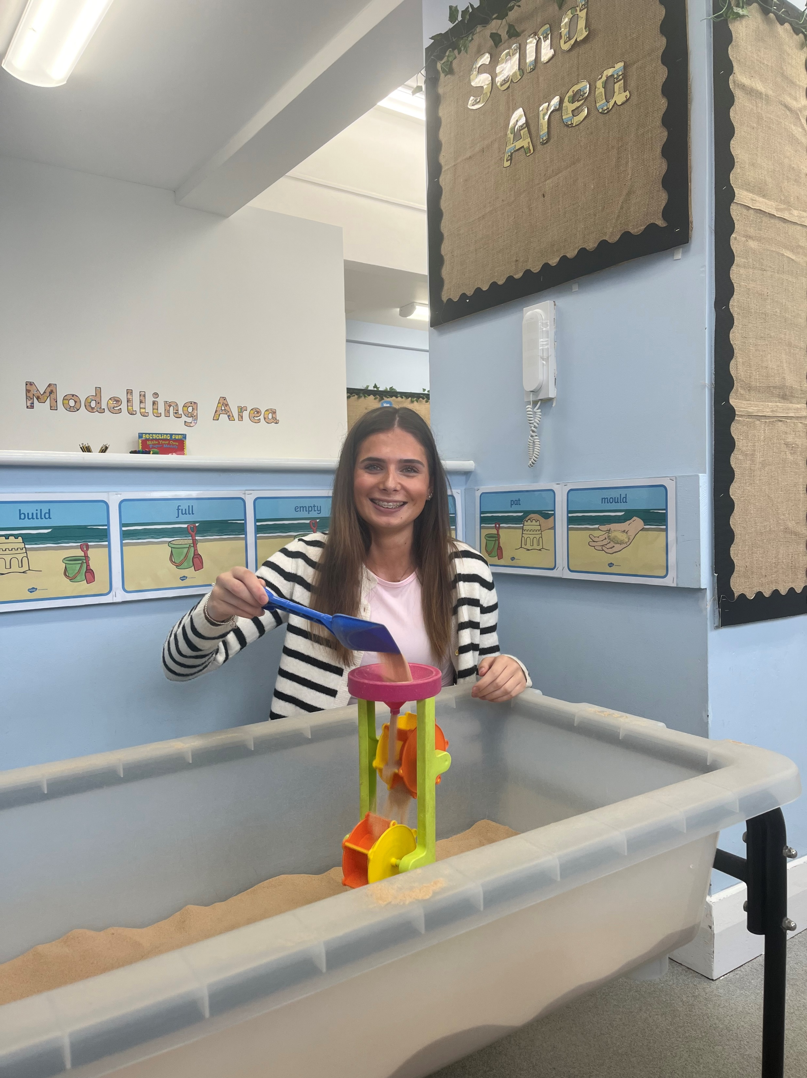
Miss Procter

Slide 10
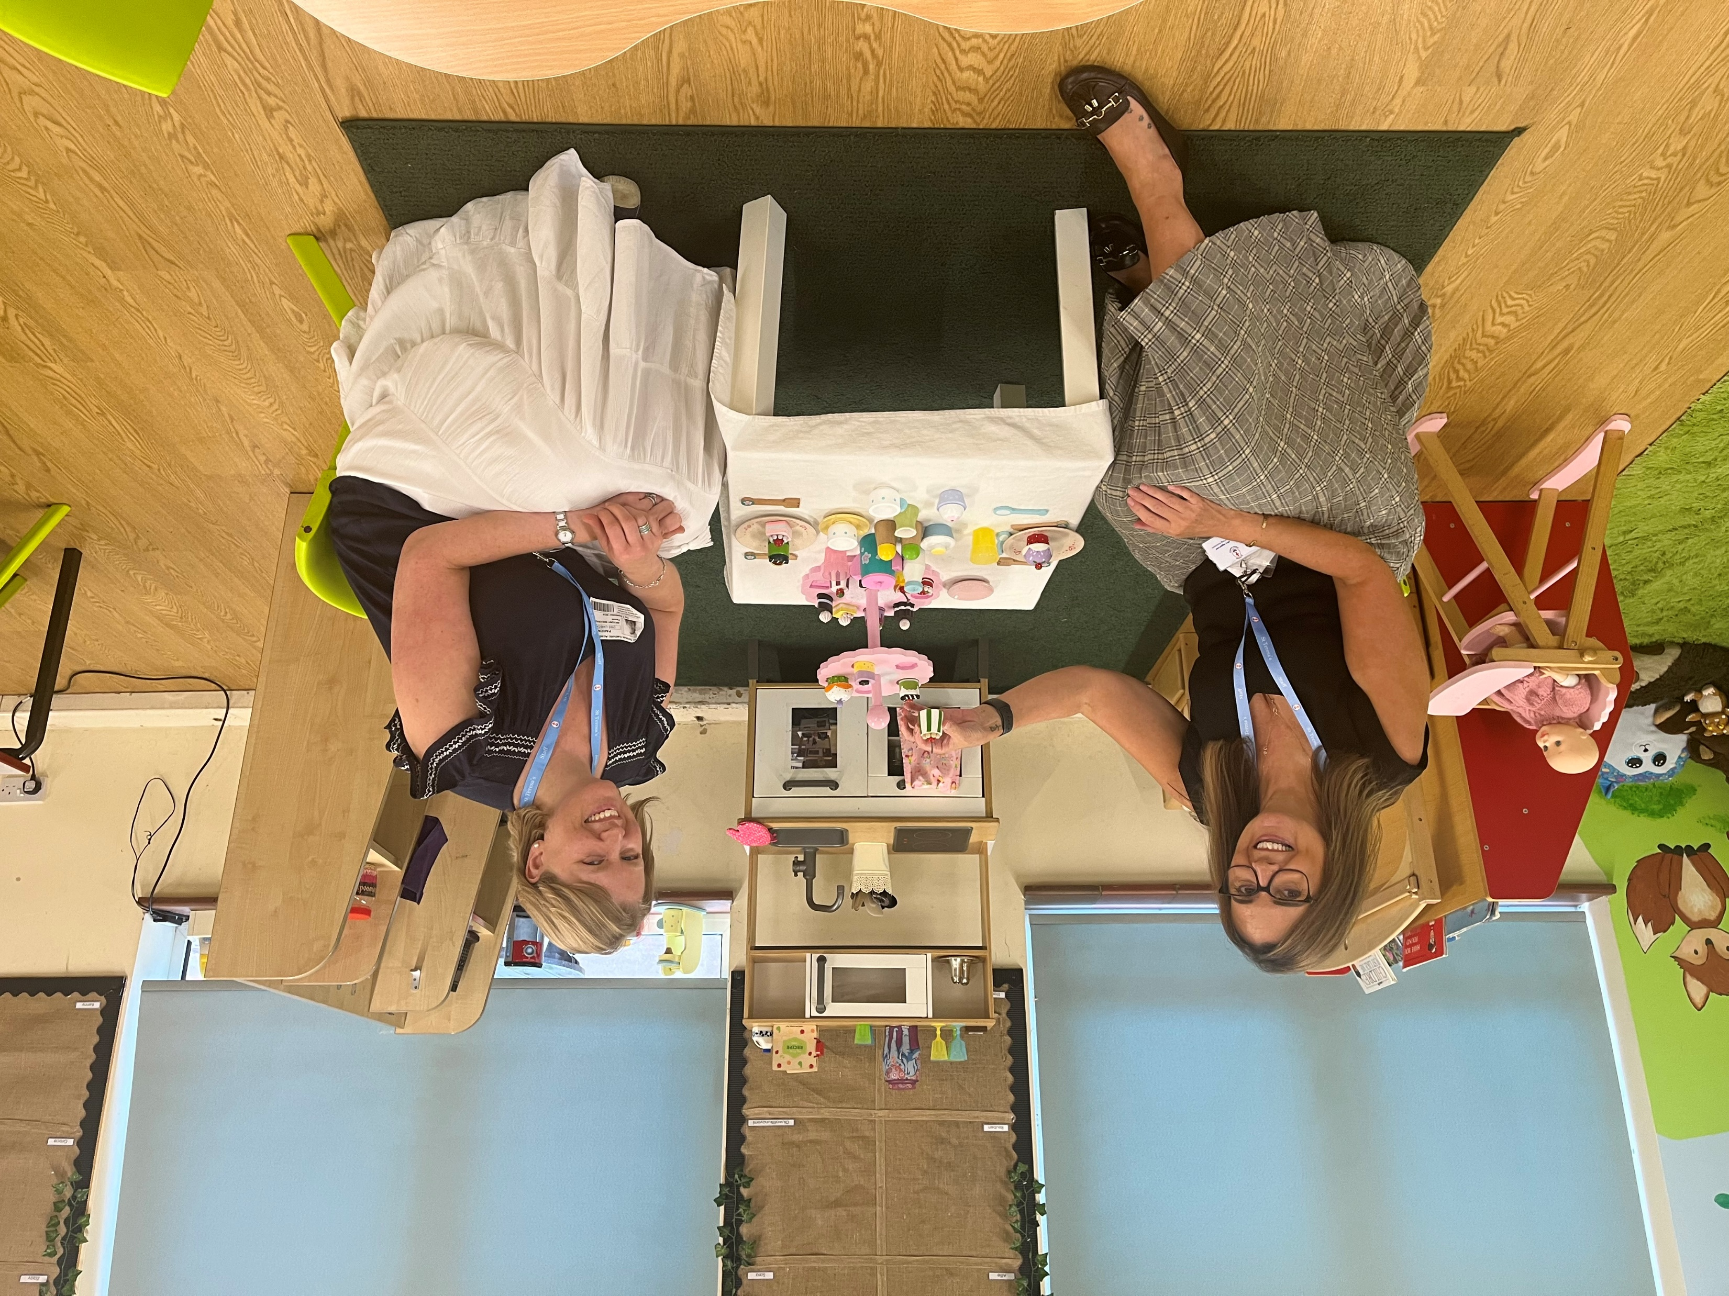
Mrs Aggarwal and
Mrs Sullivan

Slide 11
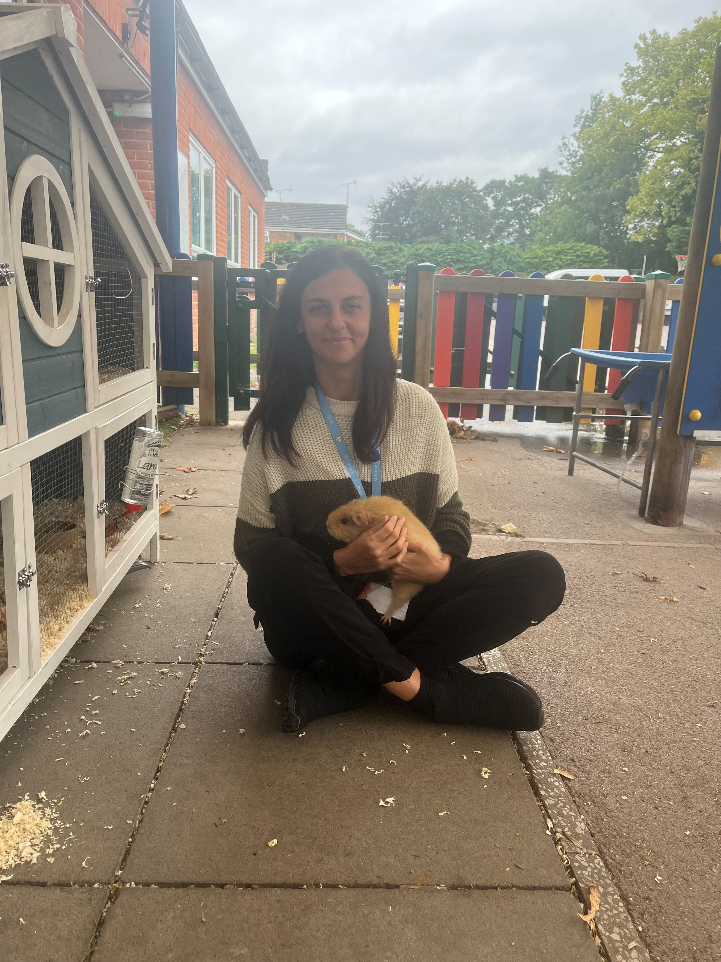
Miss Goddard

Slide 12
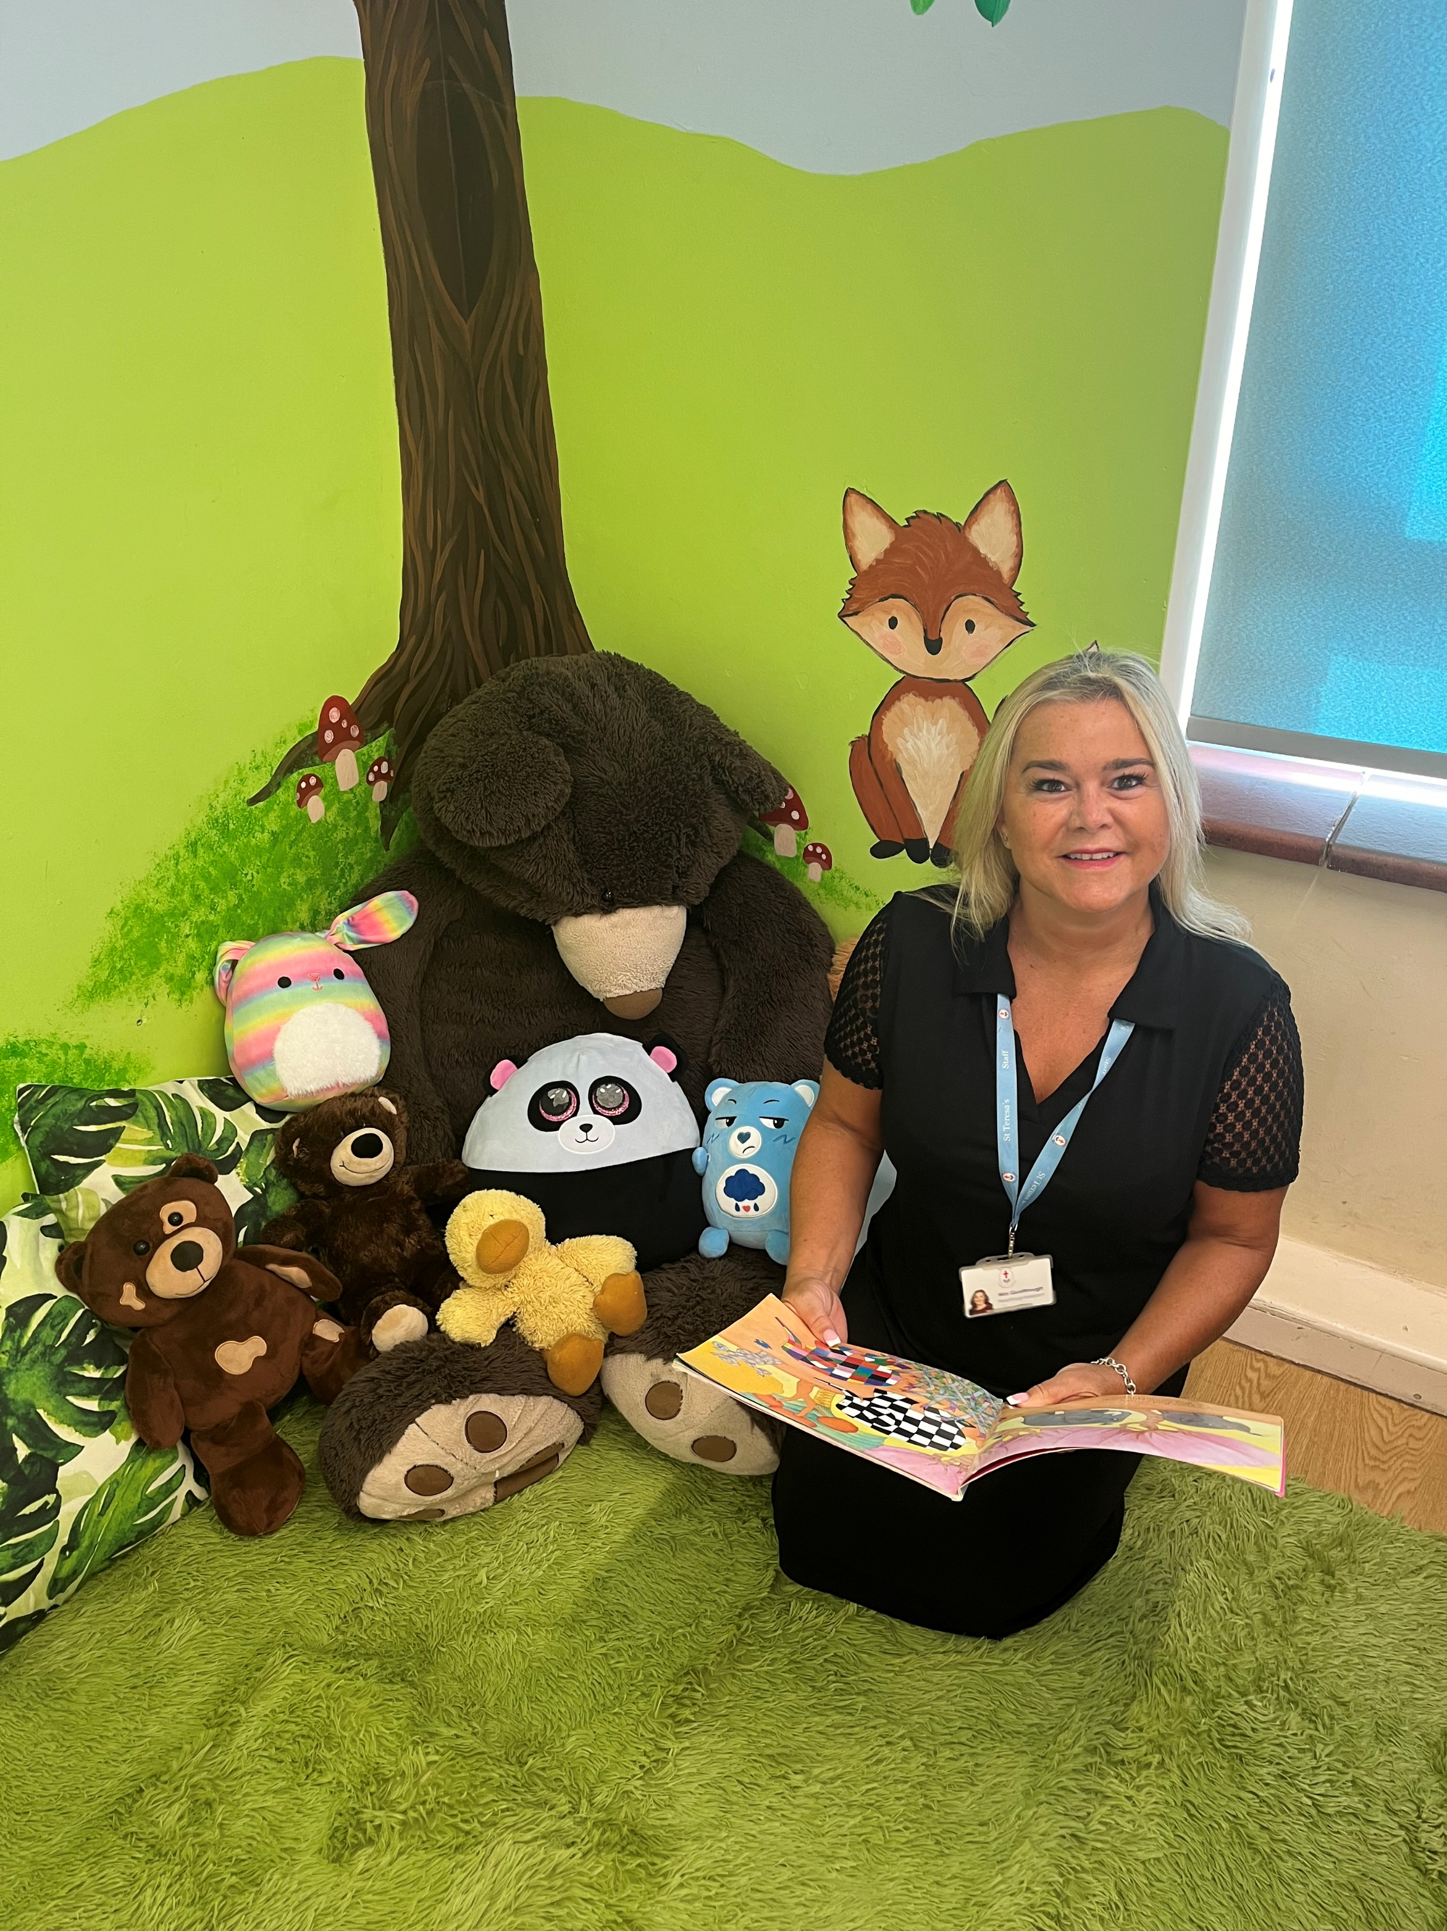
Mrs Q

Slide 13
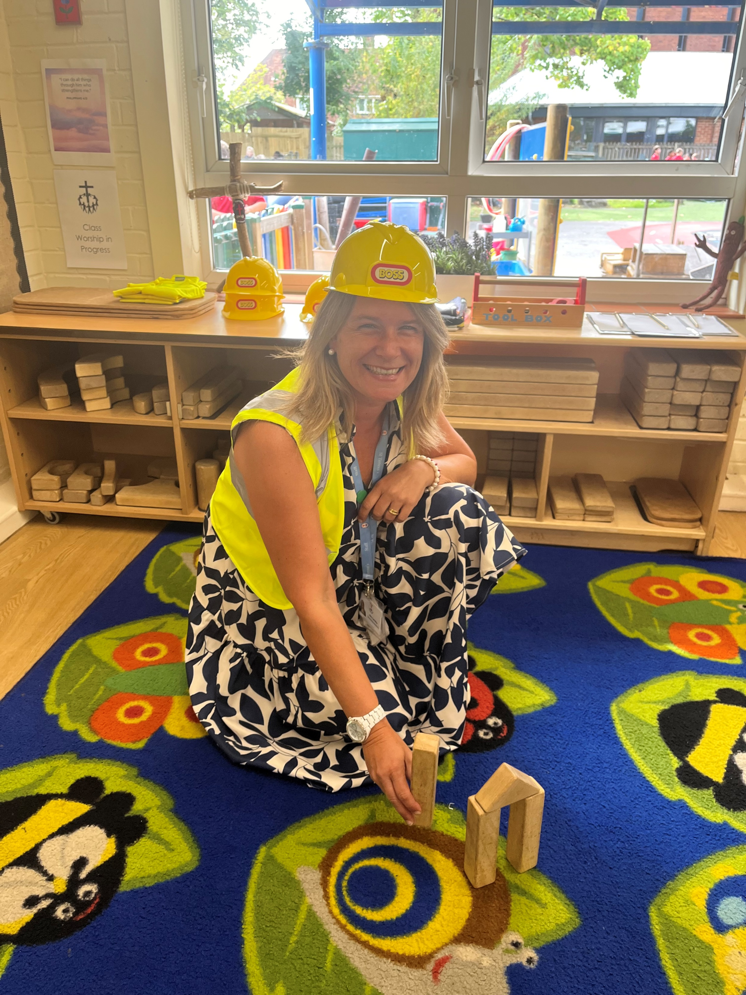
Mrs Carrilho

Slide 14
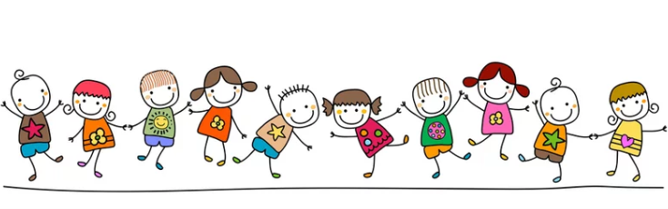
Where can I play?

Slide 15
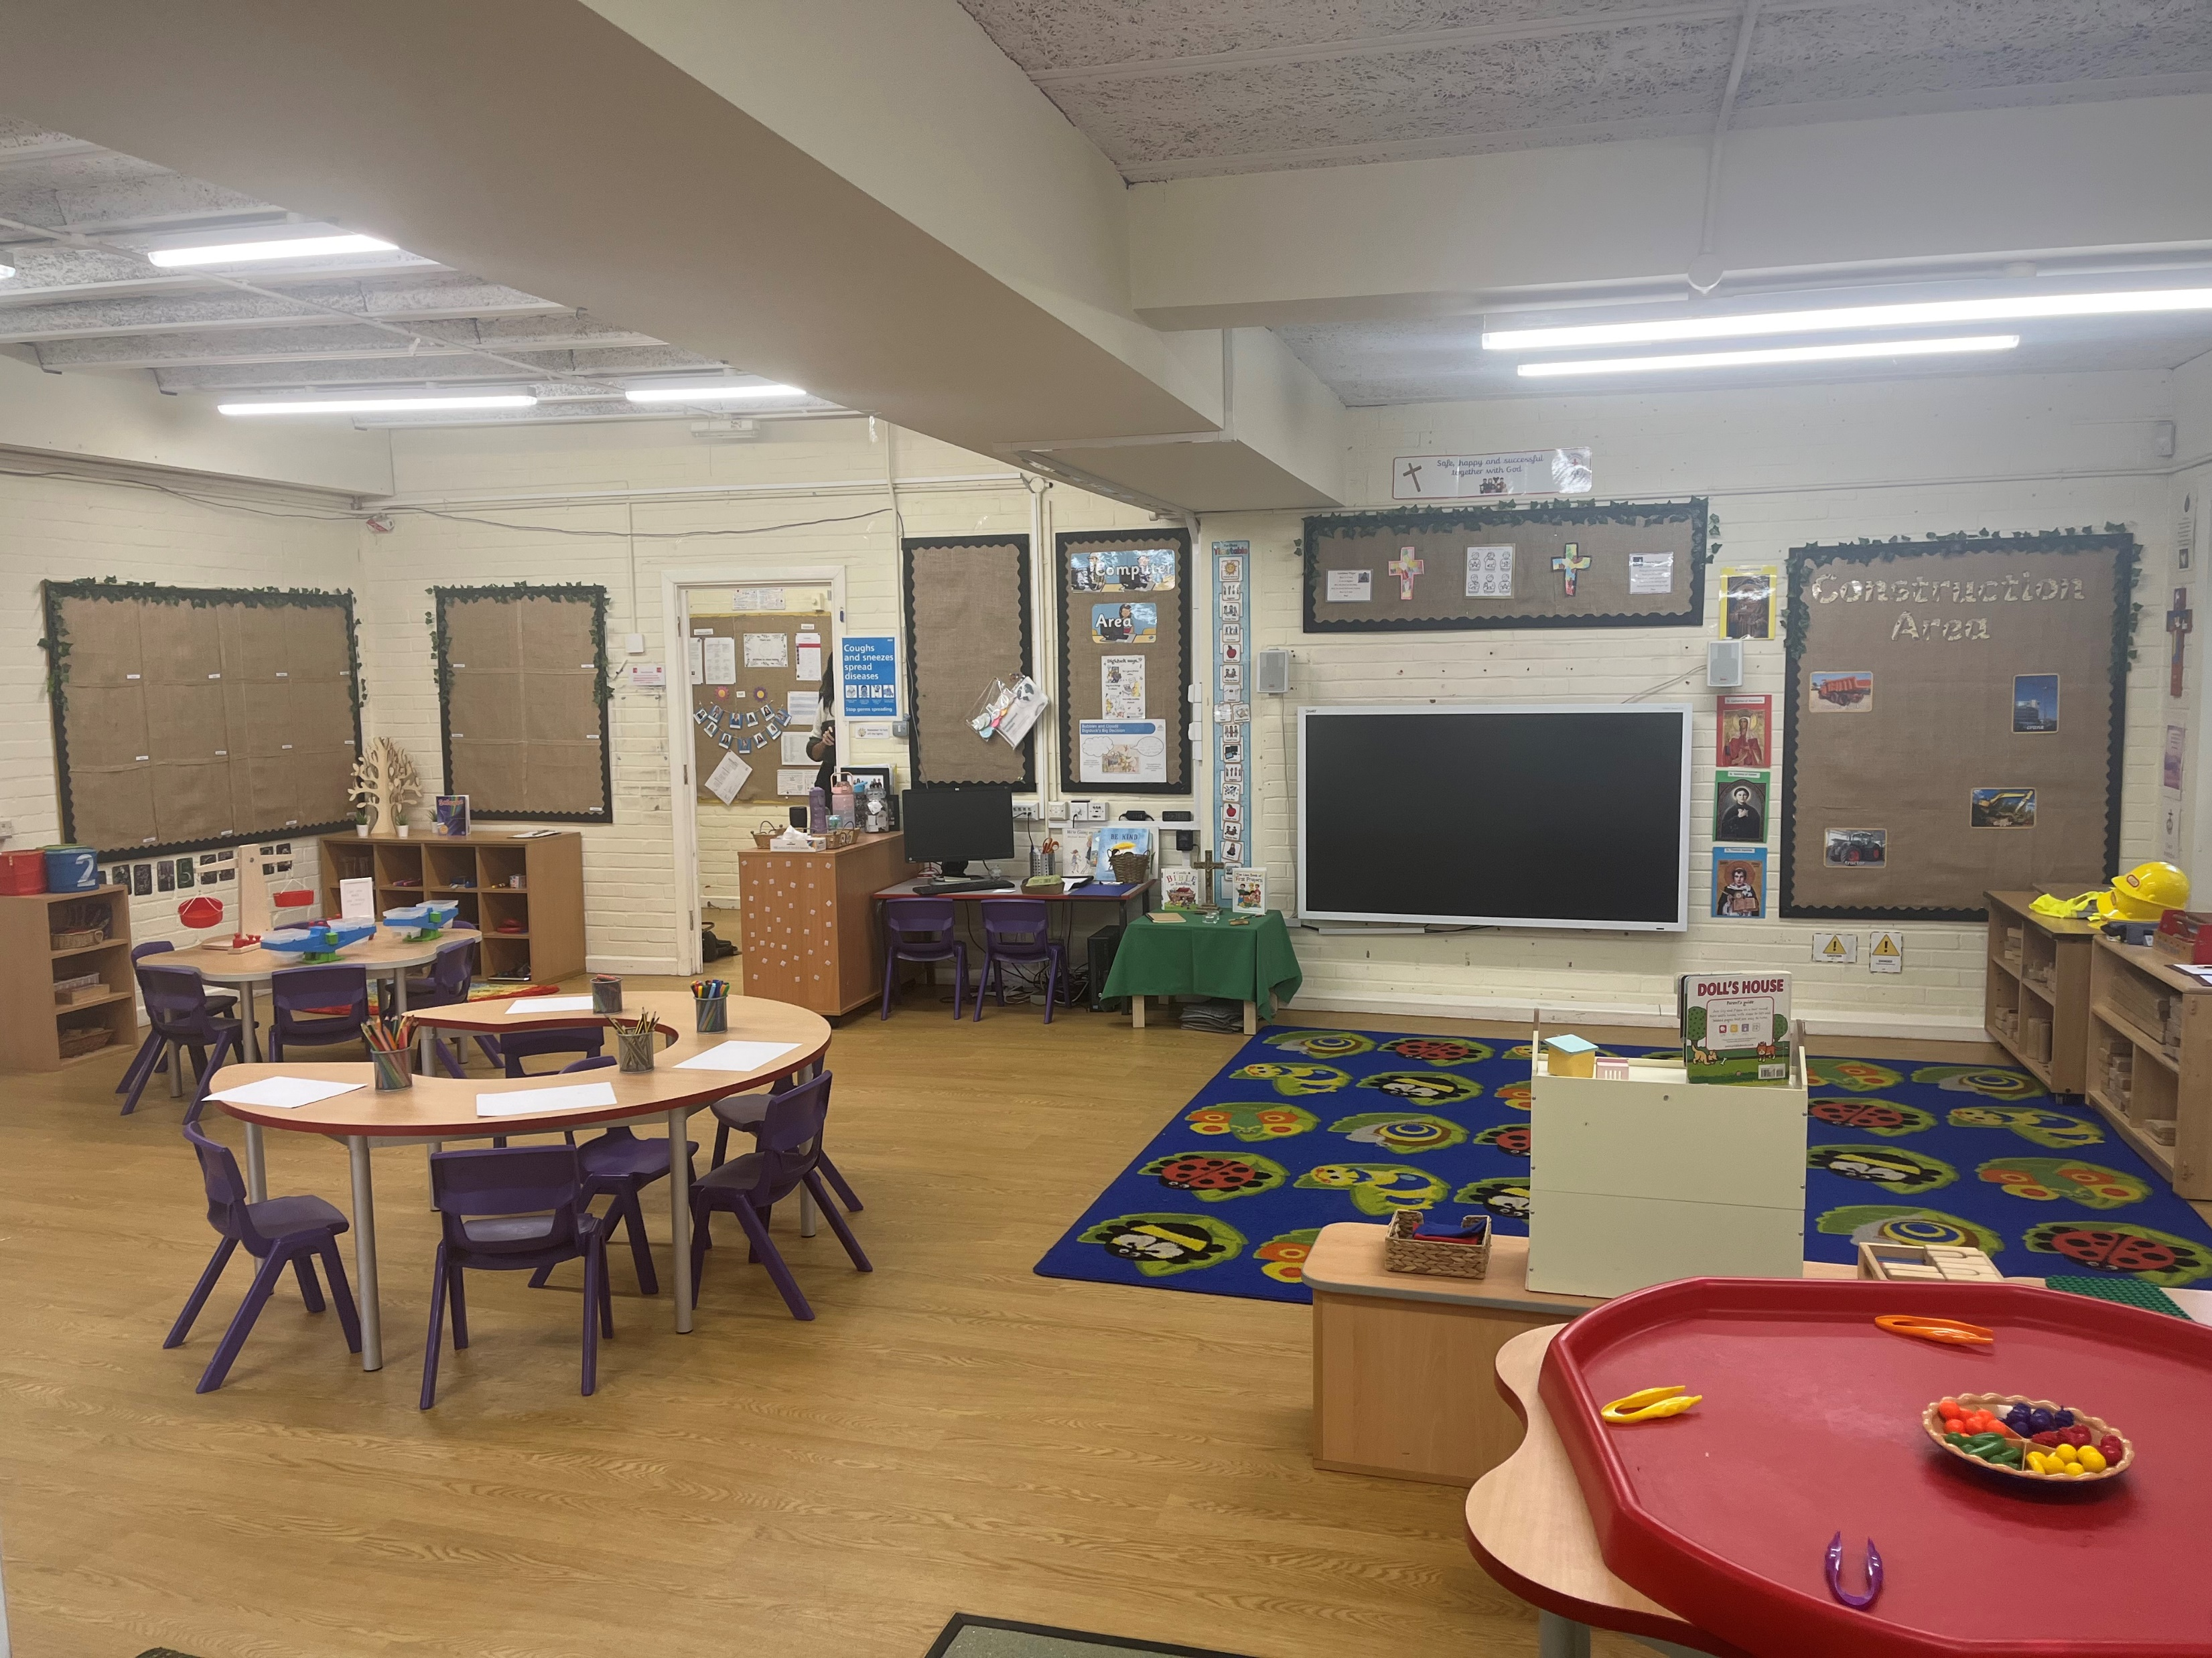
Tamar 1

Slide 16
Tamar 2

Slide 17
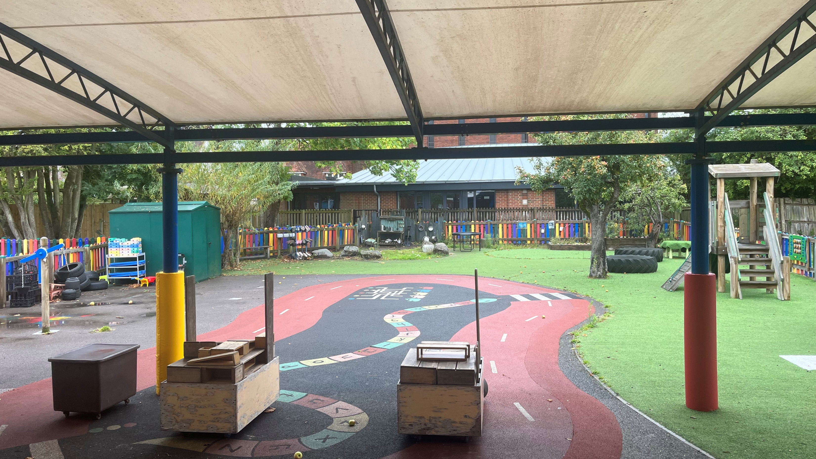
Tamar Garden

Slide 18
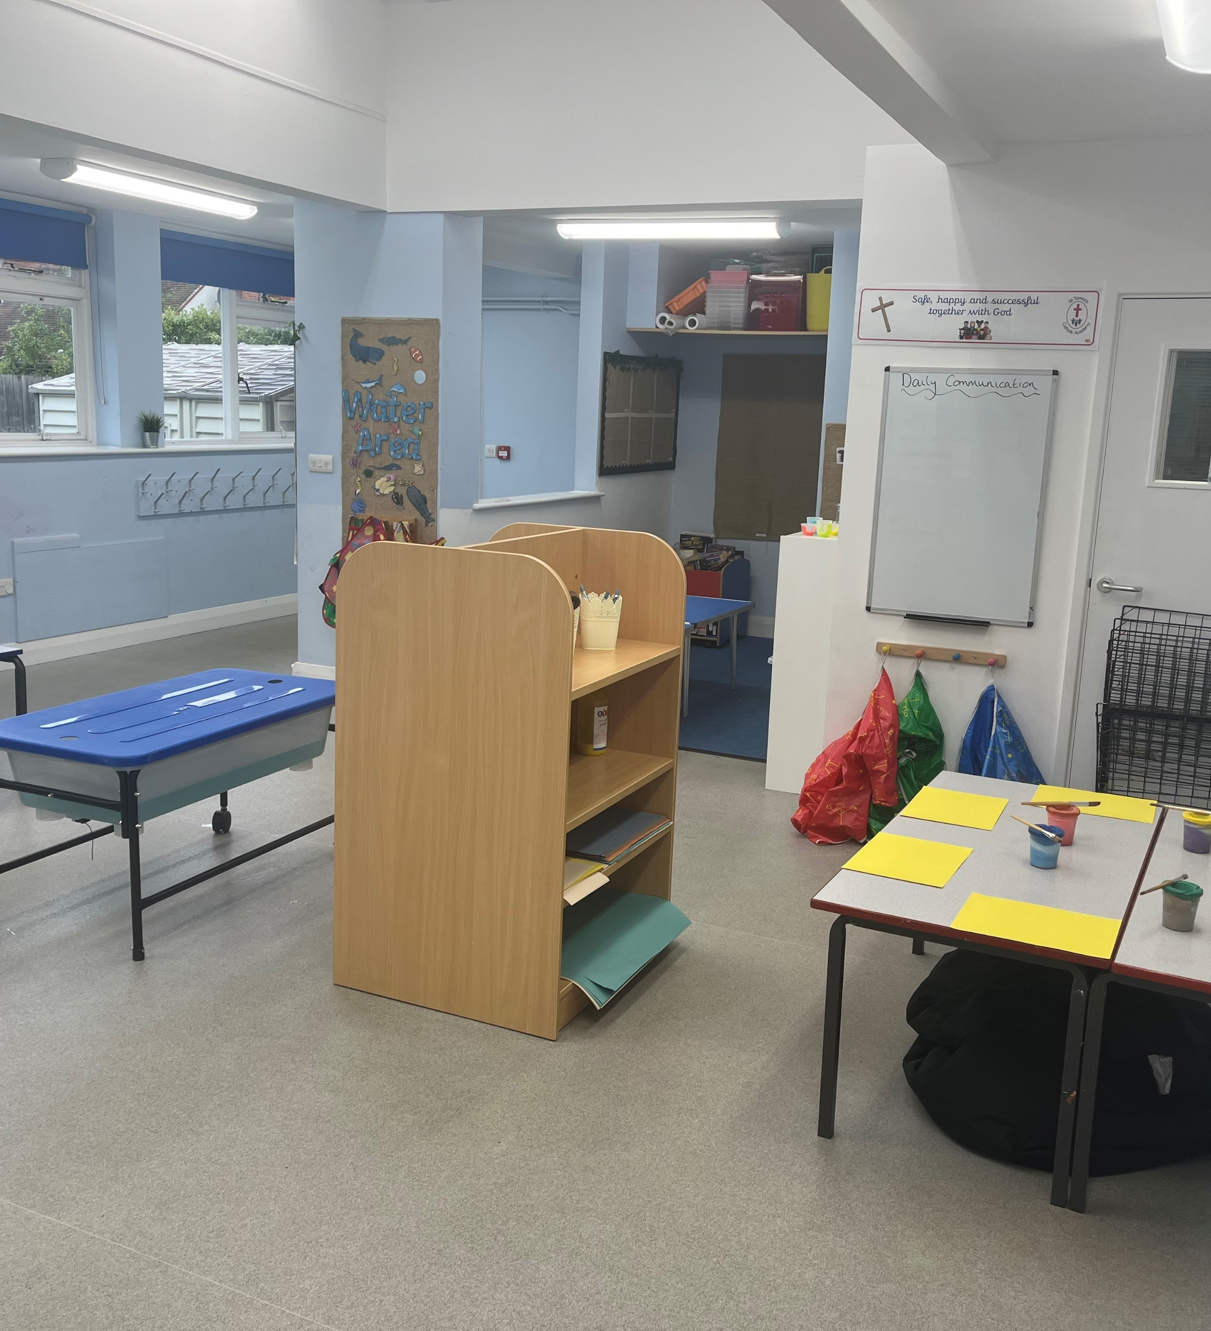
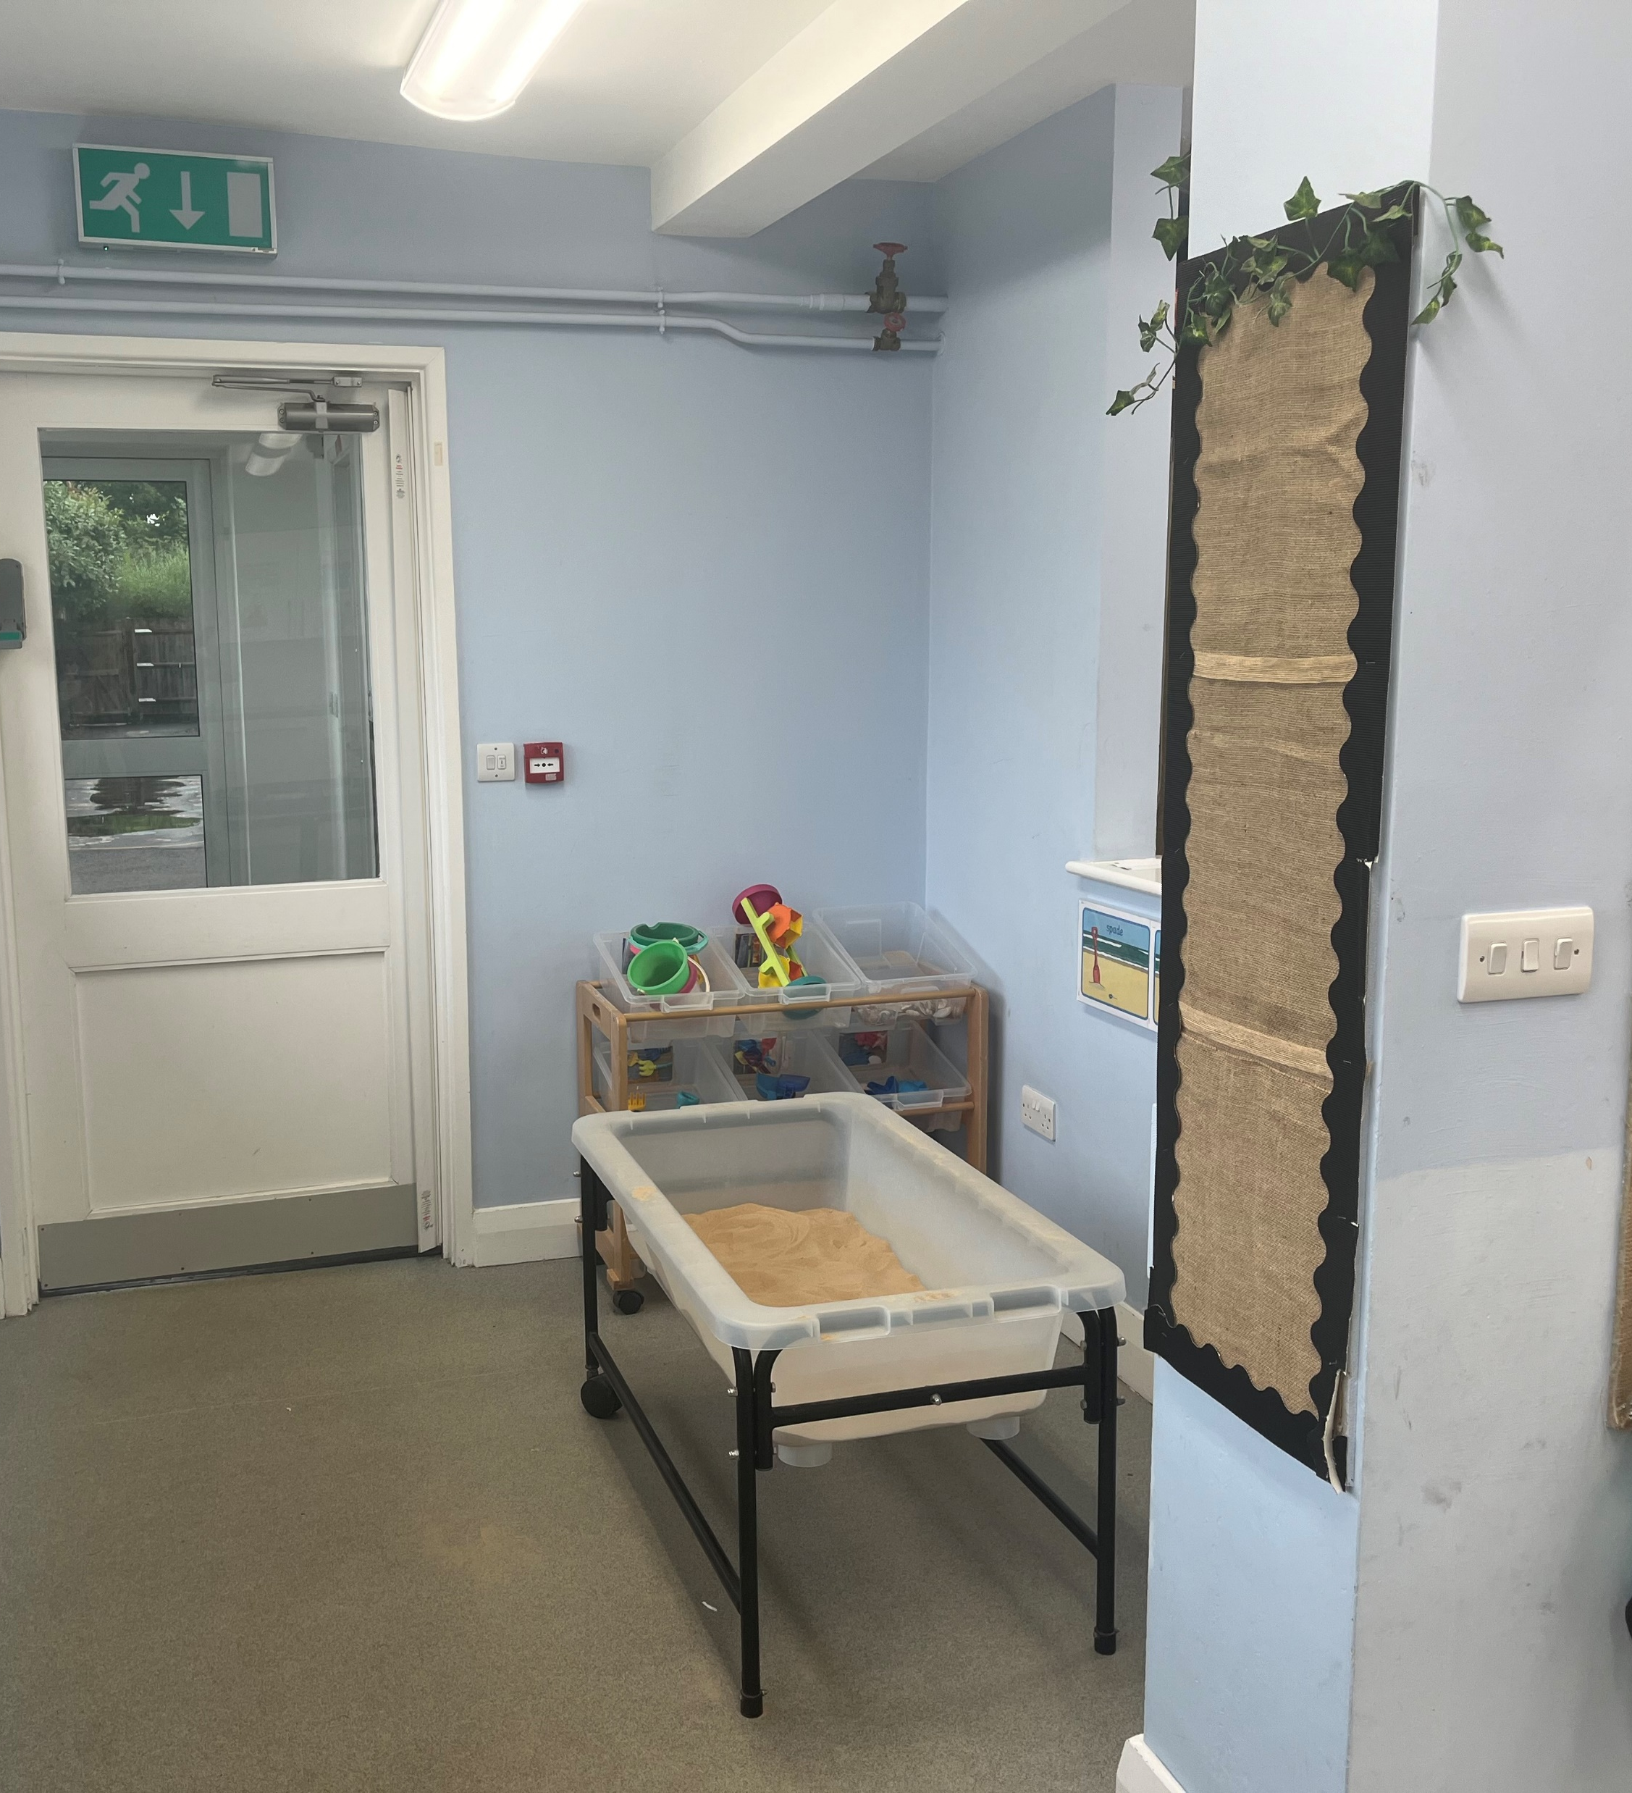
Messy room

Slide 19

Where will I learn?

Slide 20
Tamar 1 and Tamar 2 classrooms

Slide 21

Where can I go to the toilet?

Slide 22
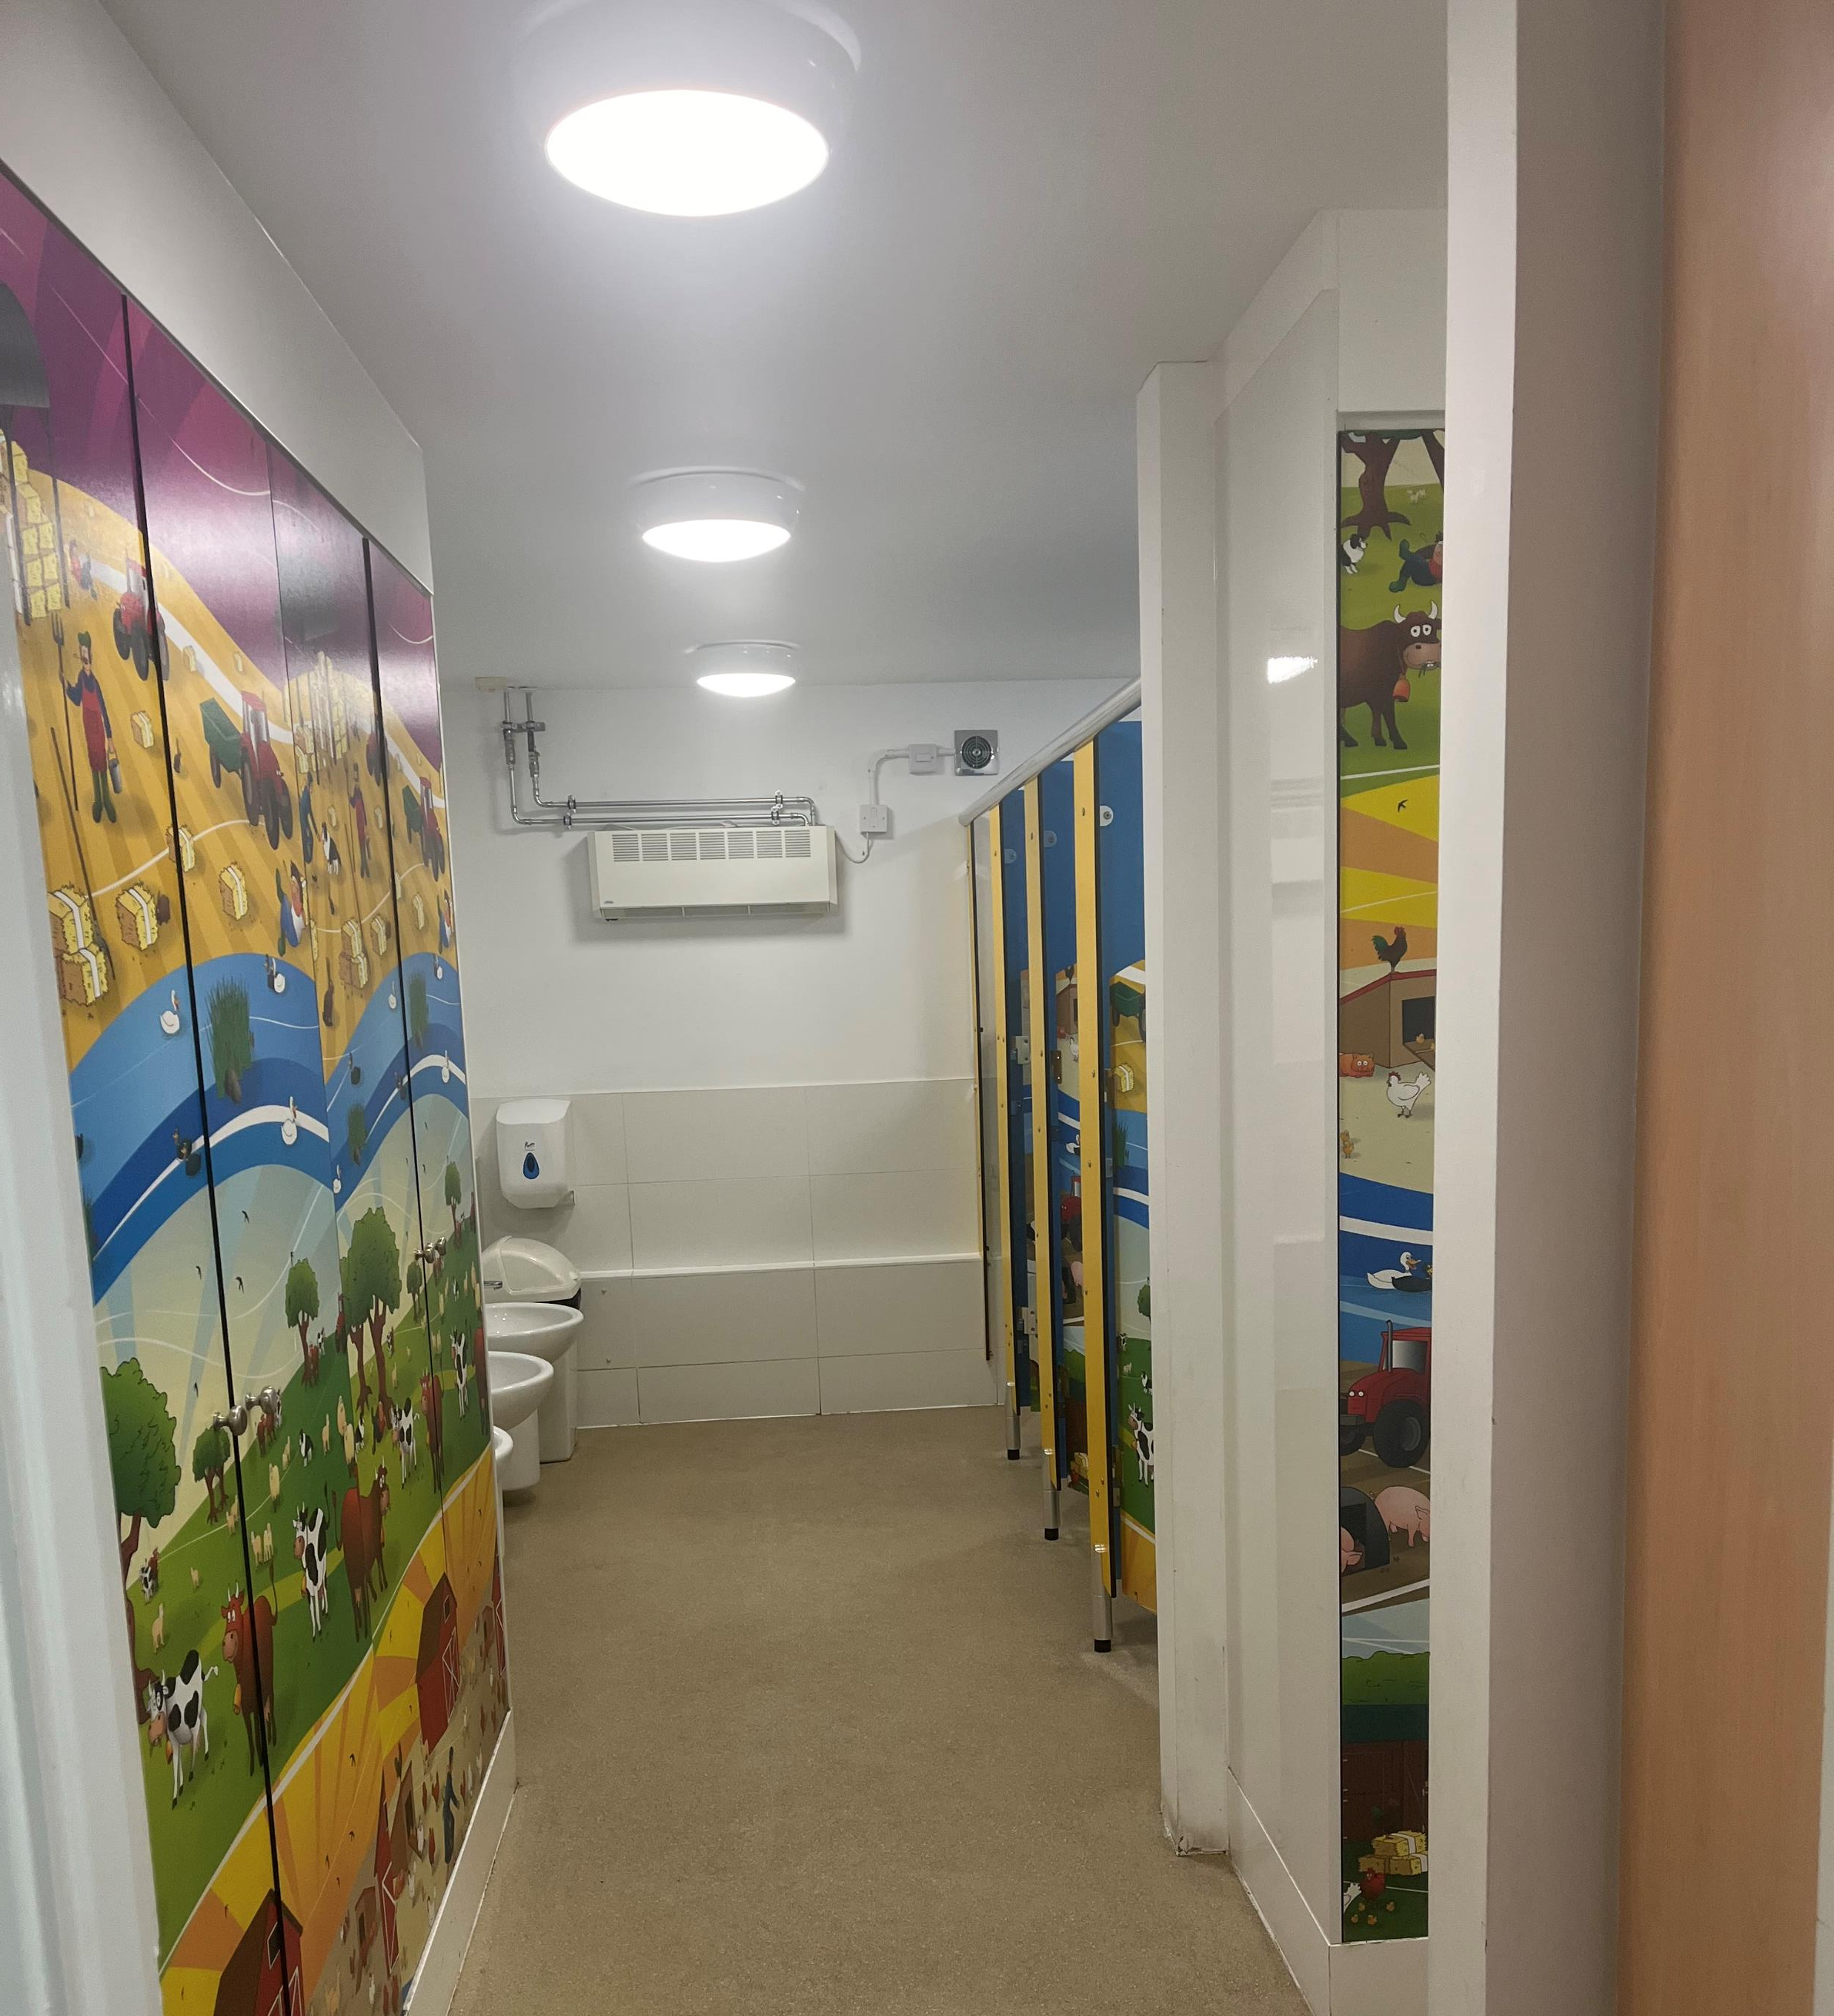
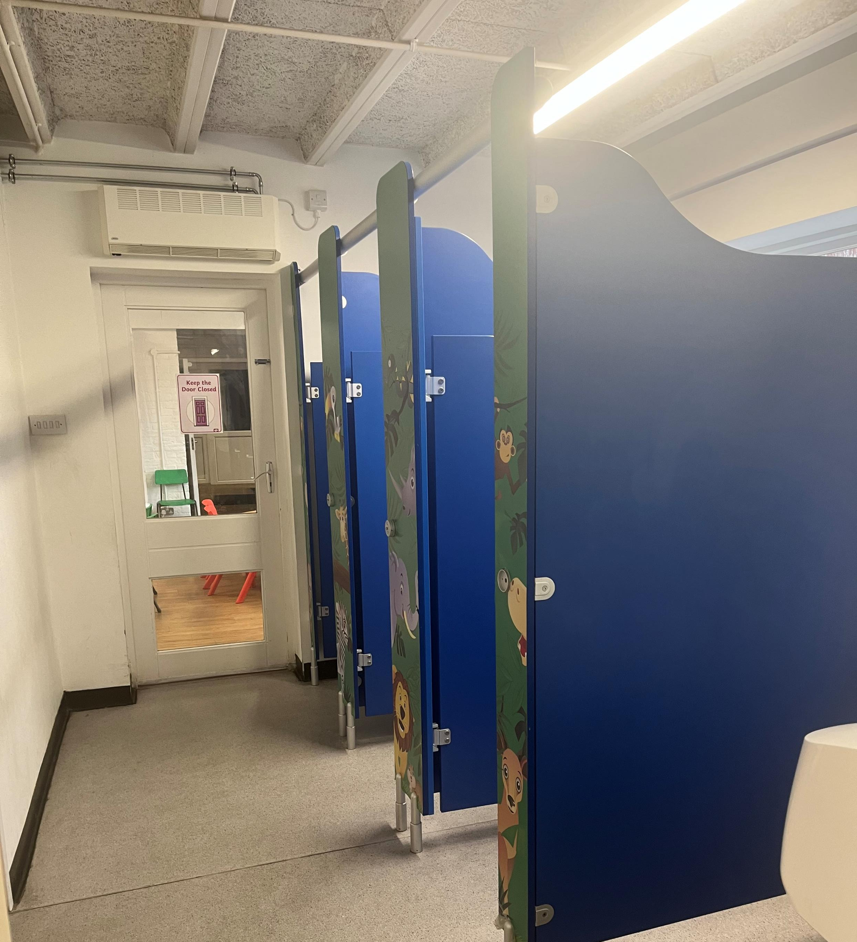
Tamar 1 and Tamar 2 toilets

Slide 23

Where will I eat my lunch?

Slide 24
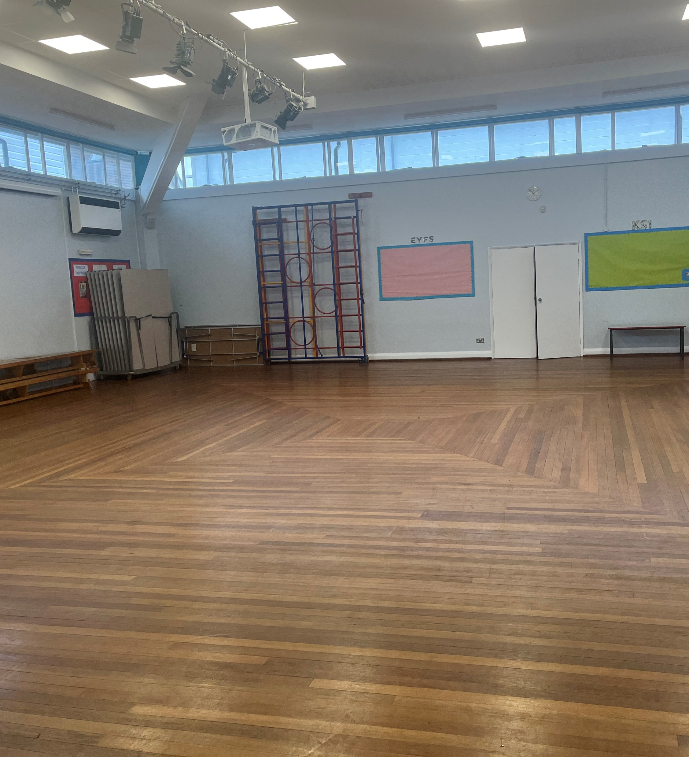
The Hall or Tamar 2 classroom

Slide 25
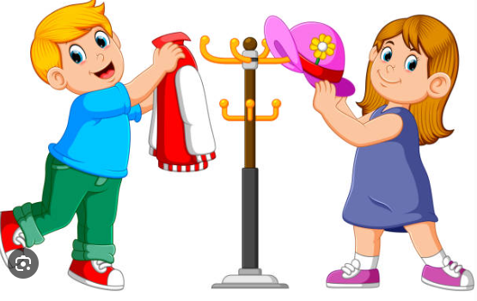
Where will I hang my coat?

Slide 26
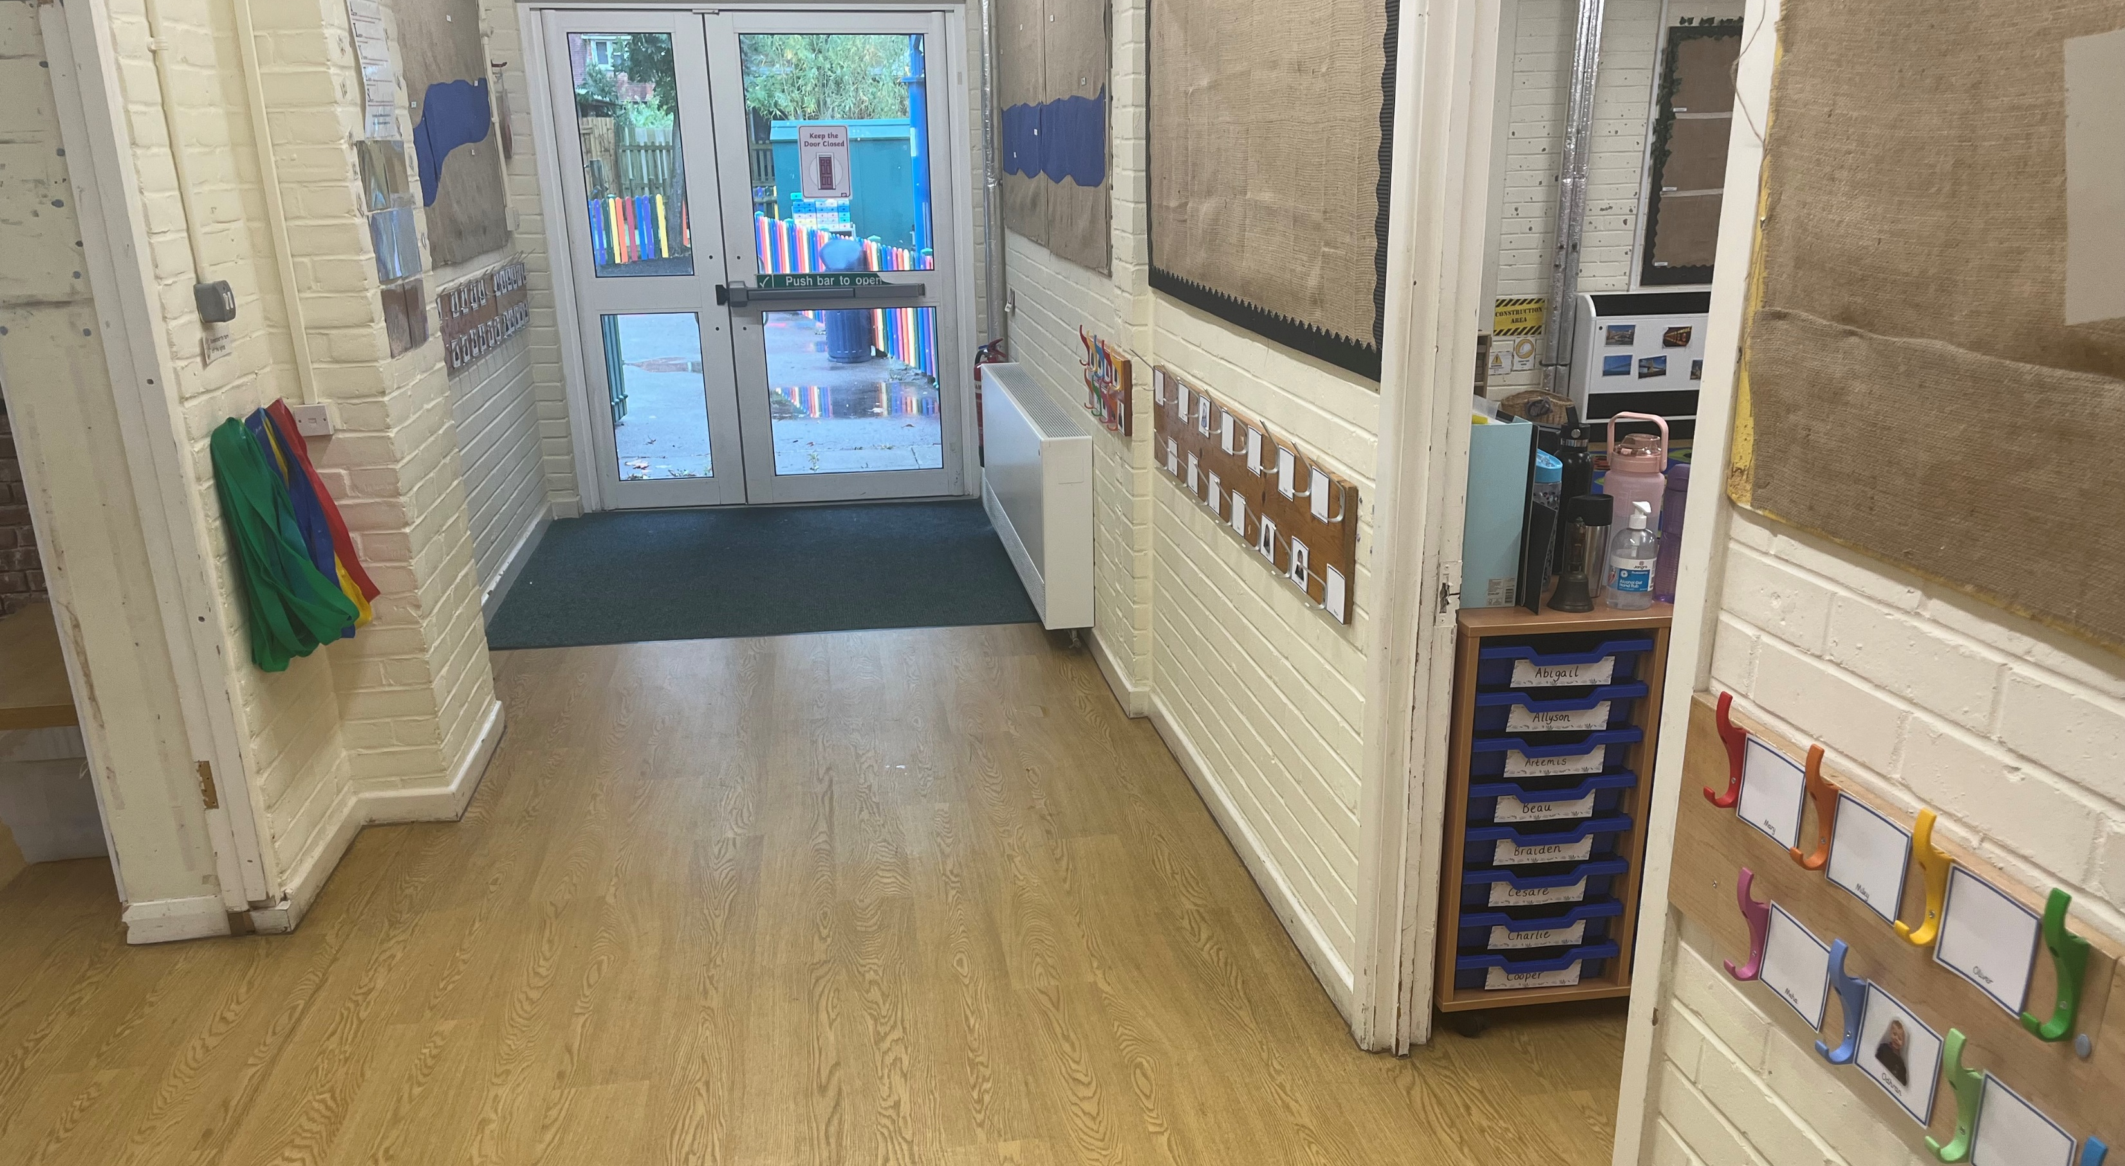
Tamar corridor

