Slide 1

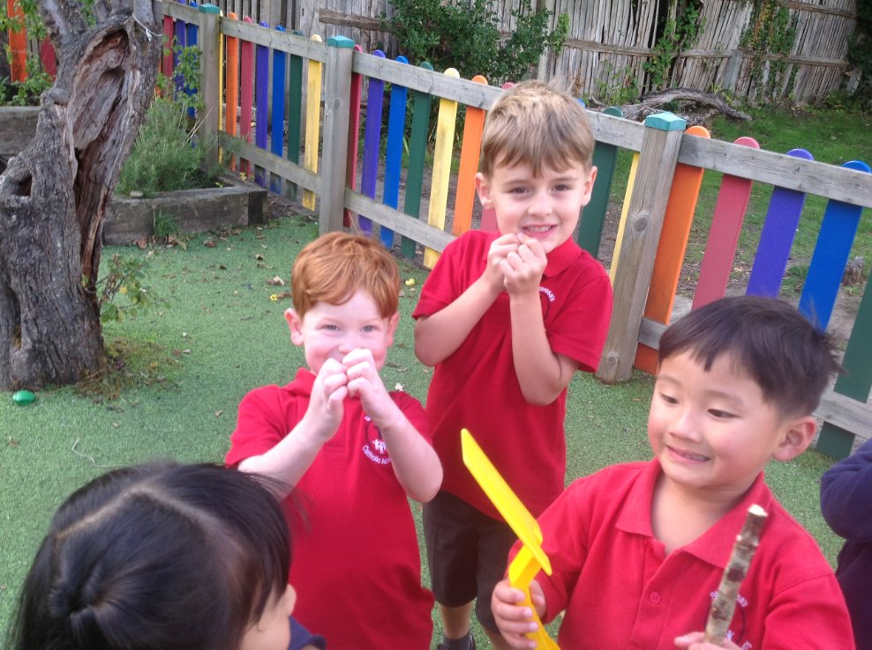
St Teresa’s Catholic Academy
Welcome to Tamar!
Safe, Happy & Successful
together with God
Notes:
Welcome
Introduction of staff and visitors

Slide 2

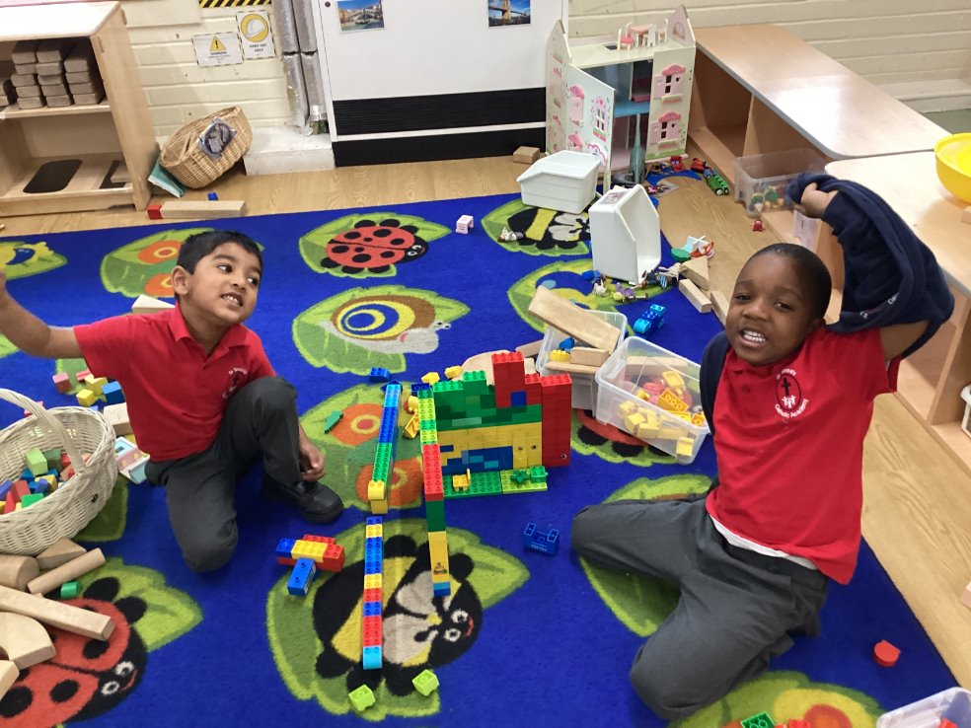
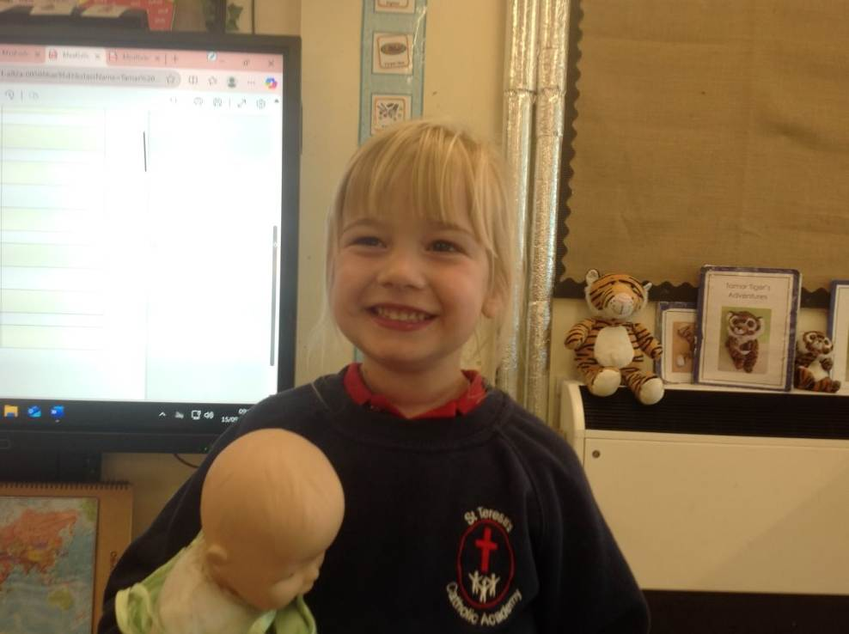
Purpose of Meeting
About us
Our community
So far in Tamar
Tour of the
Foundation Unit
Notes:
Informal – a chance to get to know each other
Key information can be found in the information pack

Slide 3
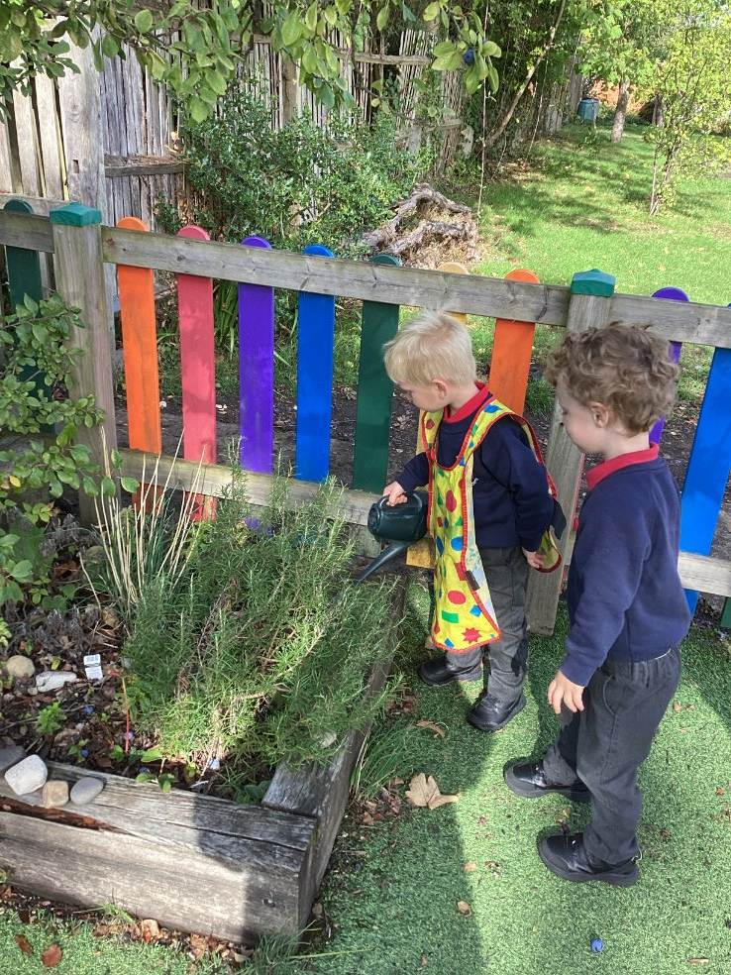
About Us
Our Catholic Ethos
Our standards
The structure of our school
Notes:
Faith underpins everything we do. Our vision statement is Safe, Happy and Successful……….
Our aim is to work with you as parents and the parish to further develop the children’s relationship with God.
Pray 3 times a day, come together for collective worship
Gospel values, behaving like disciples of Jesus in our words and actions
SAINTS acronym
Standards – High expectations of chdn, staff and parents. The way we behave, work, look – everything. Children rise to it!
Consistency & honesty , children always come first, love of learning
Encourage a Growth Mindset
Explain classes and names

Slide 4



Our Community
Parent Helpers
Parish
School
Association
Notes:
Parents – partnership – open relationship – we all want what is best for your children – volunteer/help in school
Parish – School Masses, Stations of the cross, Children involved in Parish events – Cafod Lunch
School – Staff – all go above and beyond – Govs – Introduce Charlotte SA – Introduce Laura Corbett

Slide 5
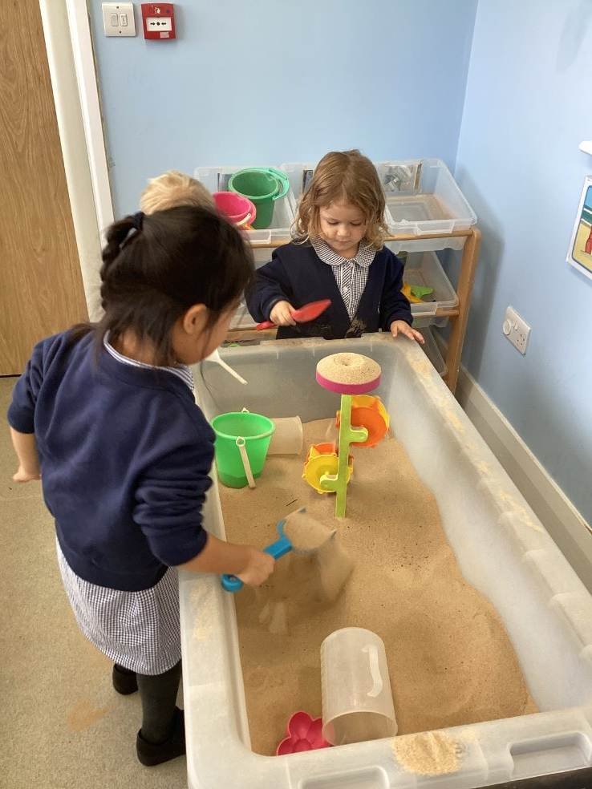
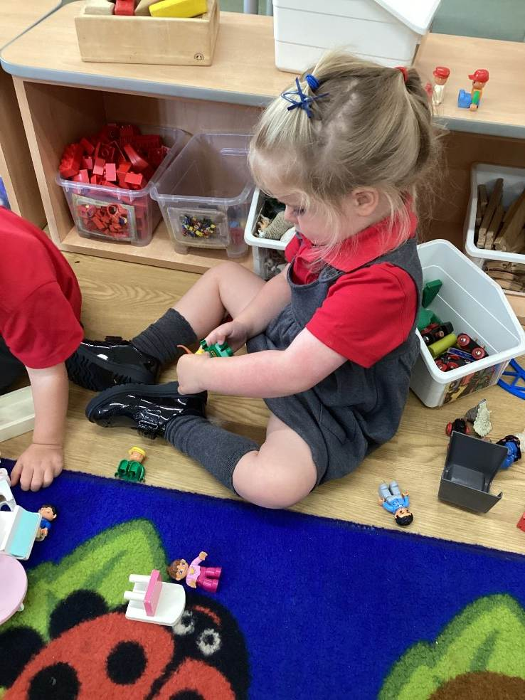
So Far in Tamar
Update
Keyworkers
The School week

Slide 6
The School Week
AM
Registration in base classroom.
Morning focus session
Free flow/Independent learning
Act of Worship.
Rolling Snack
Break
Phonics/Writing
Lunch

Slide 7
The School Week
PM
Afternoon registration in base classroom.
Afternoon Focus session
Rolling snack
Extended/Enhanced Provision
Tidy up and story time
Home time
Homework / Reading

Slide 8
EYFS Assessment
GLD – Good Level of Development
All children are assessed across early learning goals in 3 key areas: Communication and Language, Physical Development and Personal, Social and Emotional Development)
Smaller goals within this
Children have to achieve every goal in order to secure GLD, showing that they have met expected goal in all areas

Slide 9
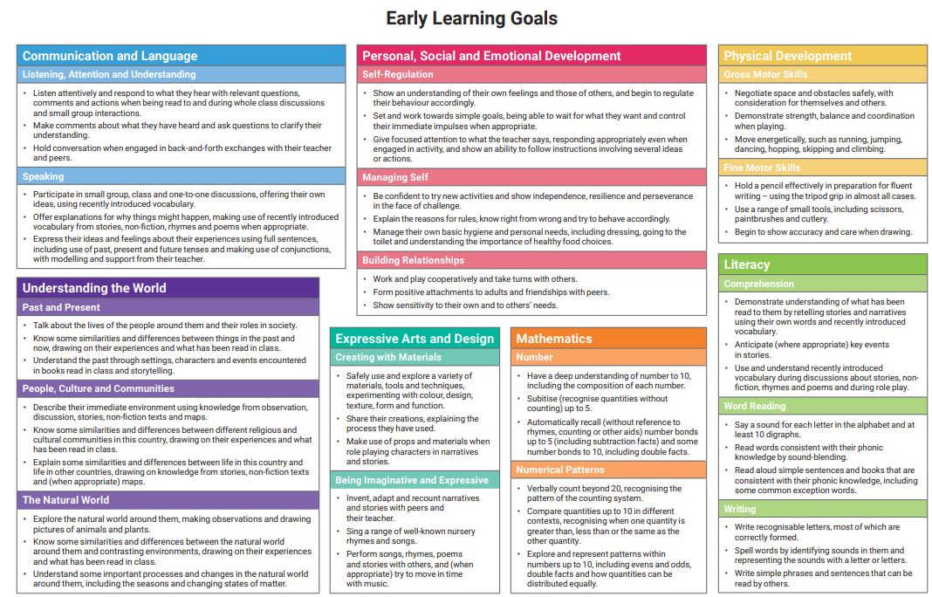
EYFS Assessment

Slide 10
Reminders
Uniform
Things needed for school
Social Media/Whatsapp

Slide 11
What happens next?
Stay and Play session
14th October
9-10am or 1:45 – 2:45
Parents Evening
21st and 22nd October – 4-7pm

