Slide 1


Slide 2
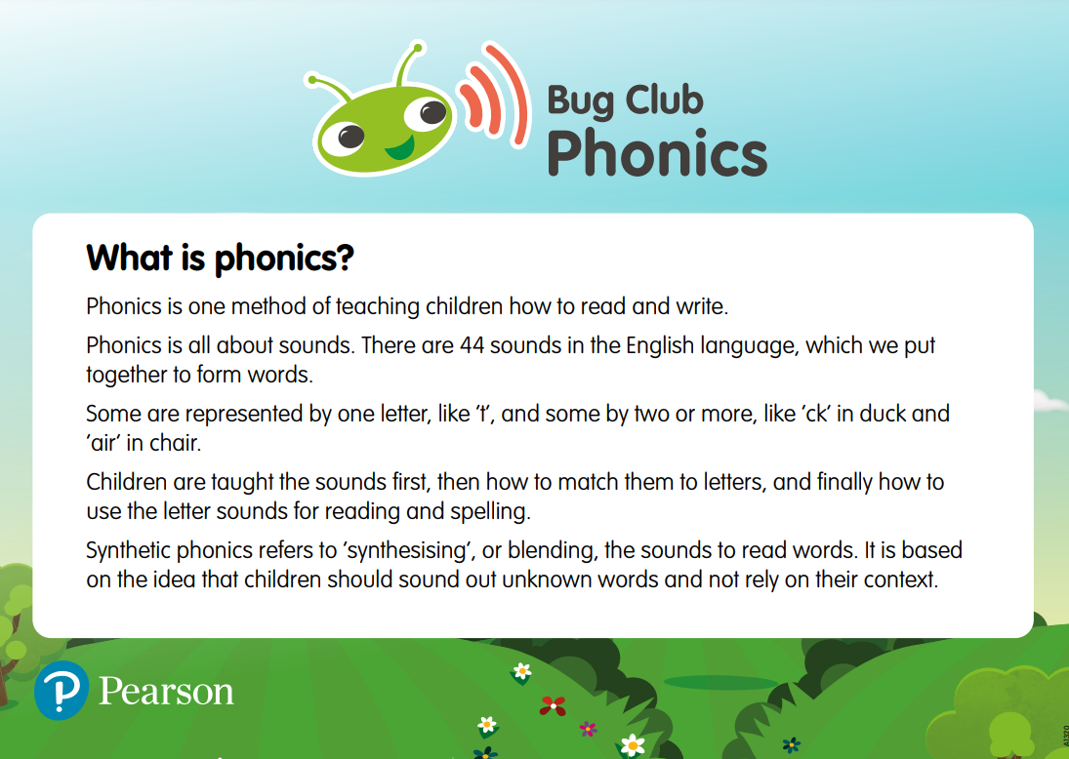

Slide 3
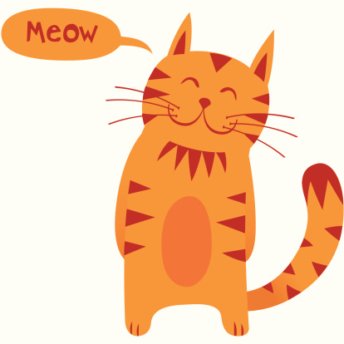

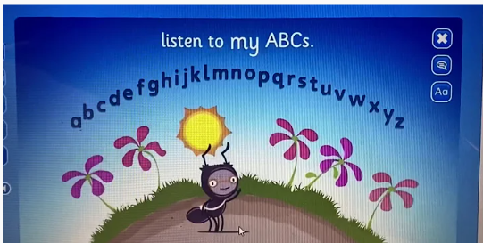

Letter Names vs Letter Sounds

Slide 4
Pure Sounds
Pure sound in phonics is the pronunciation of each letter sound clearly and distinctly without adding additional sounds to the end.
For instance, the /f/ sound is pronounced as 'f' and not 'fuh. An understanding of pure sounds will help children to blend and segment words.

Slide 5
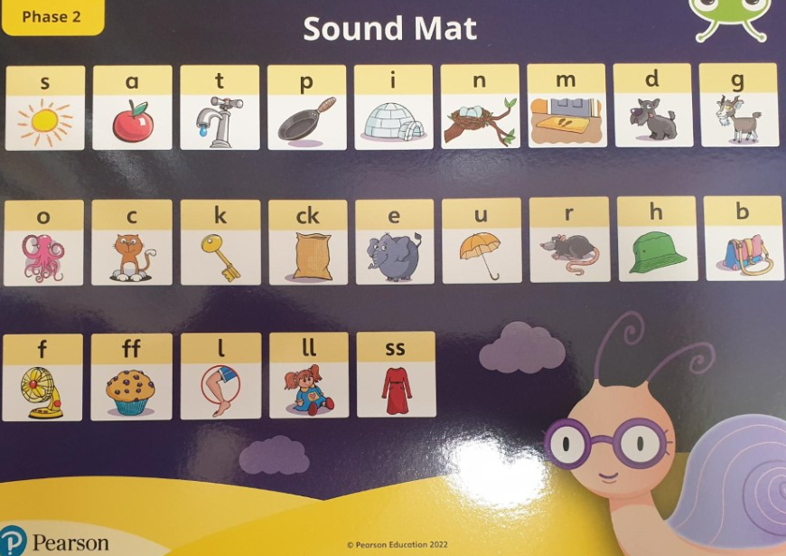
Click Here to see the correct pronunciation of the Phase 2 pure sounds*
*We do not follow the Twinkl Phonic programme but this video is an accurate representation of how to pronounce the sounds.

Slide 6
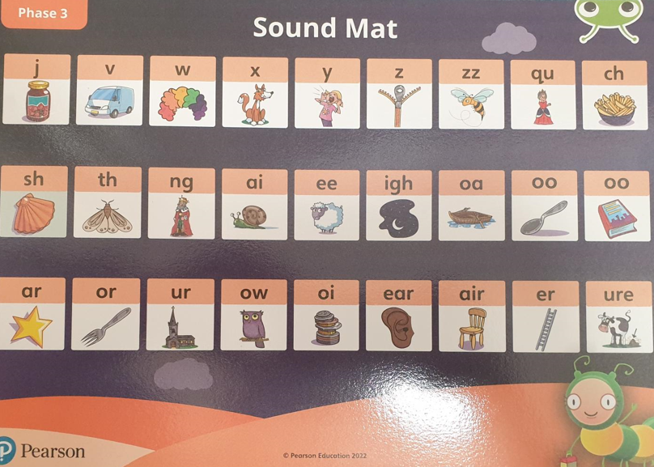
Click Here to see the correct pronunciation of the Phase 3 pure sounds*
*We do not follow the Twinkl Phonic programme but this video is an accurate representation of how to pronounce the sounds.

Slide 7
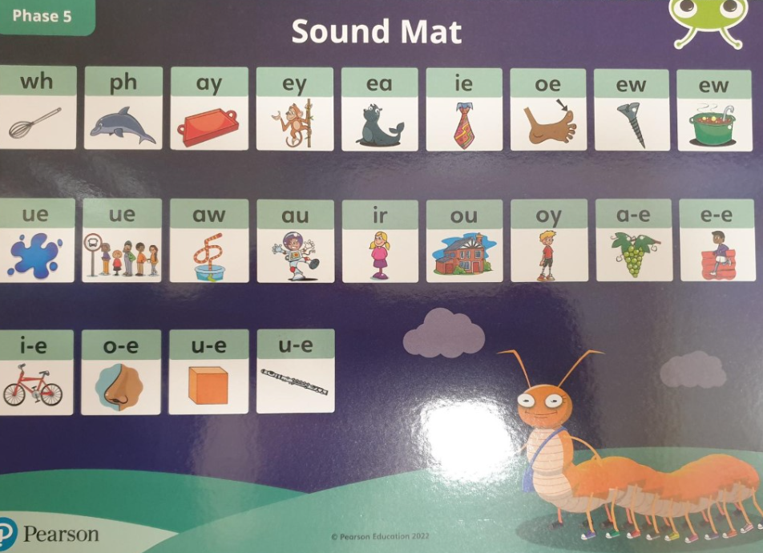
Click Here to see the correct pronunciation of the Phase 5 pure sounds*
*We do not follow the Twinkl Phonic programme but this video is an accurate representation of how to pronounce the sounds.

Slide 8
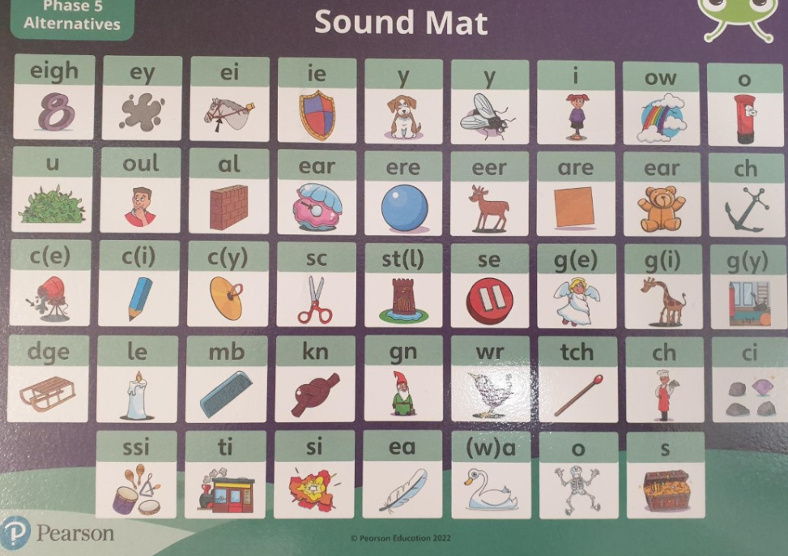

Slide 9
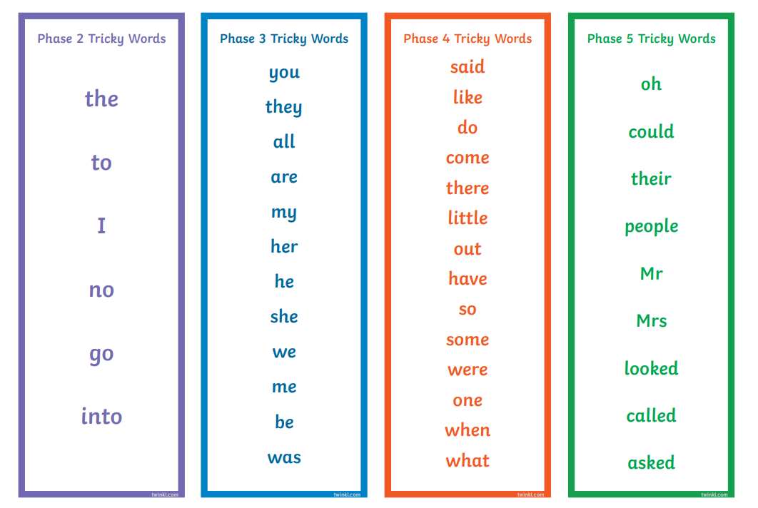
Tricky Words

Slide 10
Actions for Oral Blending & Segmenting

Slide 11
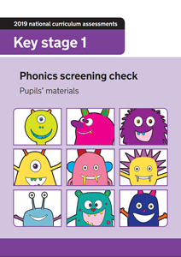
Year 1 Phonics Screening Test
40 words
Combination of real and nonsense words AKA ‘alien words’
Children who do not pass the test in Year 1 , repeat in Year 2

Slide 12
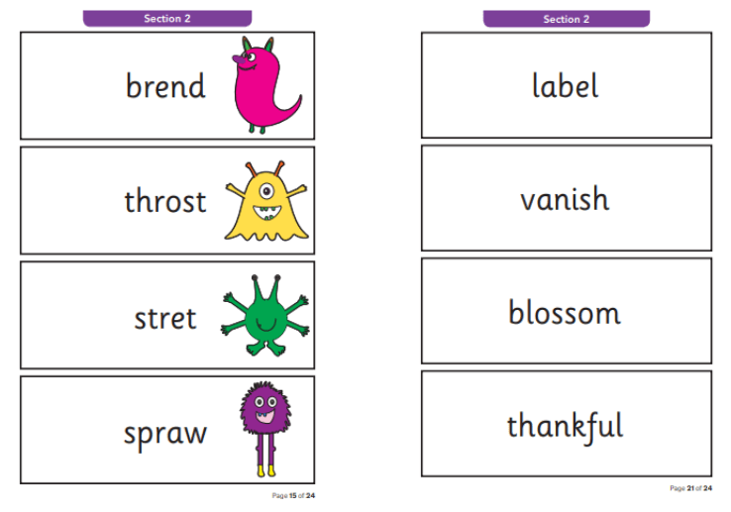
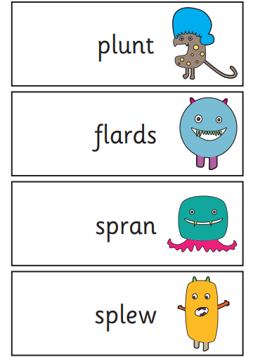
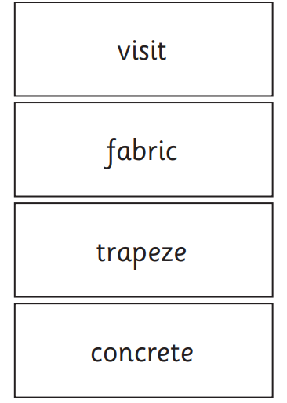
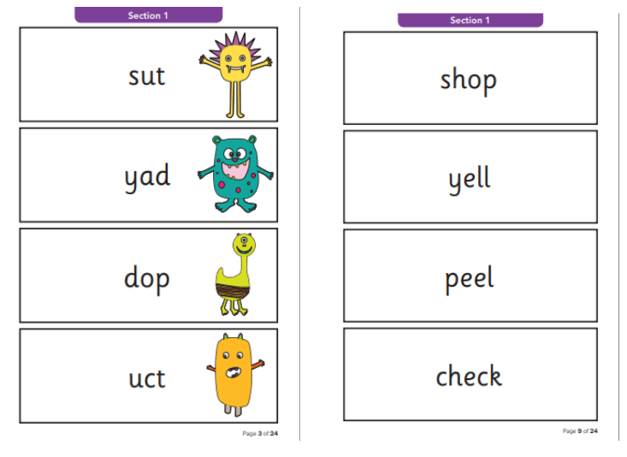

Slide 13
Reading Books

Slide 14
Reading
Wordless Picture Books
There is no right or wrong way to read a wordless picture book!
A great resource to develop language and play with new vocabulary.
Conversations around what is happening in the pictures will develop their comprehension (understanding) of what is happening. You may even notice there are things in the pictures that are unfamiliar, which could be a great conversation starter. They may look at the pictures and refer back to their own life and experiences, creating valuable learning links.
Sharing wordless books will build important literacy skills. Including listening skills, vocabulary, comprehension, and awareness of how stories are ‘built’.
For a book with few words you’ll be surprised at all the talking you will do and the fun you will have!
Top Tips for reading wordless picture books will have been sent home with your child’s first reading book.

Slide 15

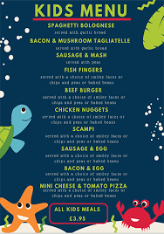
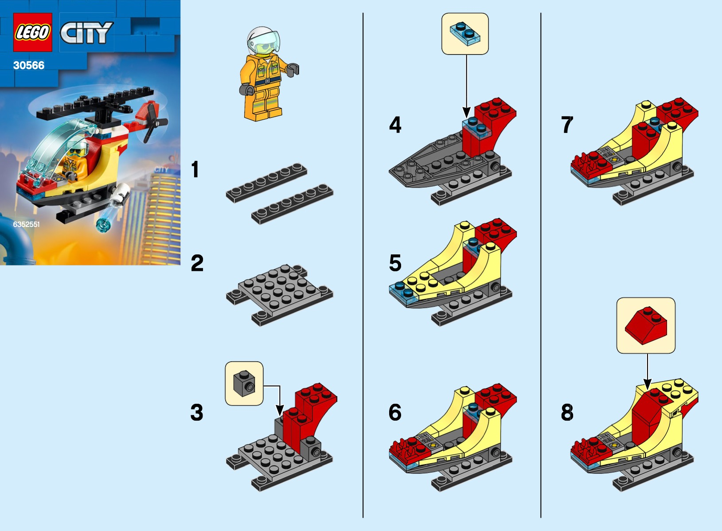

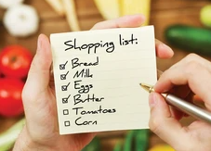

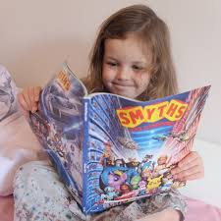
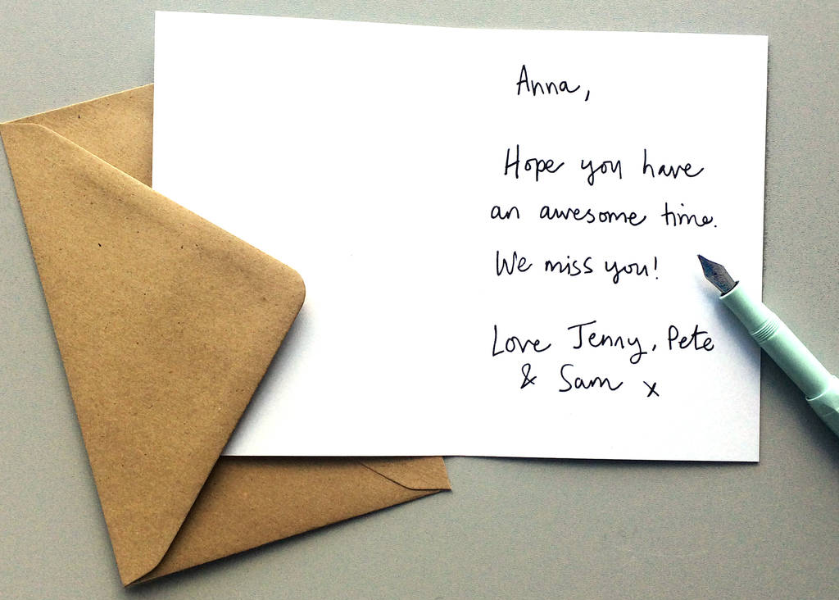

Reading is all around
Symbols
Calendars and timetables
Recipes
Instructions and Manuals
Leaflets and posters
Road signs and Car number plates
Shop labels and shopping lists
Comics and magazines
Catalogues
Post it notes
Letters and postcards
Menu
Birthday cards and tags

Slide 16
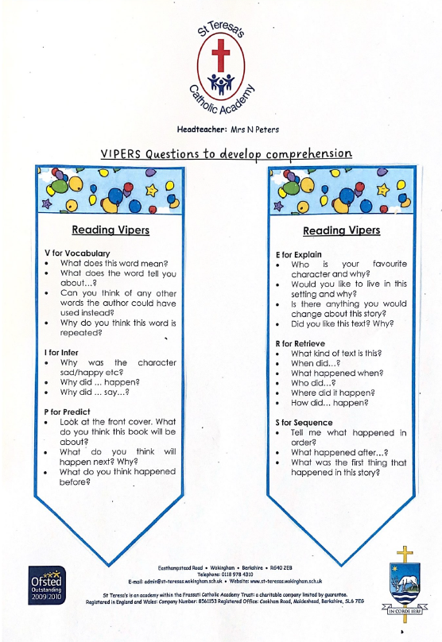
Comprehension
Comprehension is just as important as decoding!
Read each book more than once and continue to talk to your child about their book
Reading VIPERS: Vocabulary, Infer, Predict, Explain, Retrieve, Sequence
Asking questions based around these elements will develop your child’s comprehension skills.

Slide 17
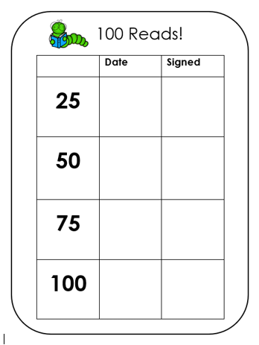
100 Reads
Incentive used across the whole school
Keep a tally of each time your child reads with an adult at home.
Once you reach each milestone, date the appropriate column in the front of your child’s reading record

Slide 18
Expectations
Phonics practise
Sending books into school daily in book bags
Reading at least 3 times a week – checked in school
Sign and date reading records
Importance of repetition
Reading for pleasure

Slide 19
Any questions?

